Slide 1
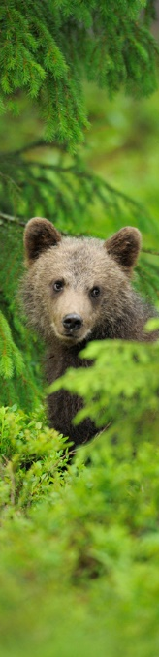
ConnectGreen Projekt Restoring and managing ecological corridors in mountains as the green infrastructure in the Danube basin
Green Carpathians webinar
25.09.2020
CEEweb for Biodiversity
Dr. Nagy Gabriella Mária
Notes:
1

Slide 2
Aims at maintaining and improving the ecological connectivity between natural habitats in the Carpathian ecoregion
Maintain and improve the ecological connectivity between natural habitats, especially Natura 2000 and other protected area categories of transnational relevance in the Carpathian ecoregion through...

Slide 3
Threts
Infrastructure development
Fragmentation of habitats
Loosing ecosystem services
Decreasing biodiversity
Climte change
Lack of cooperation

Slide 4
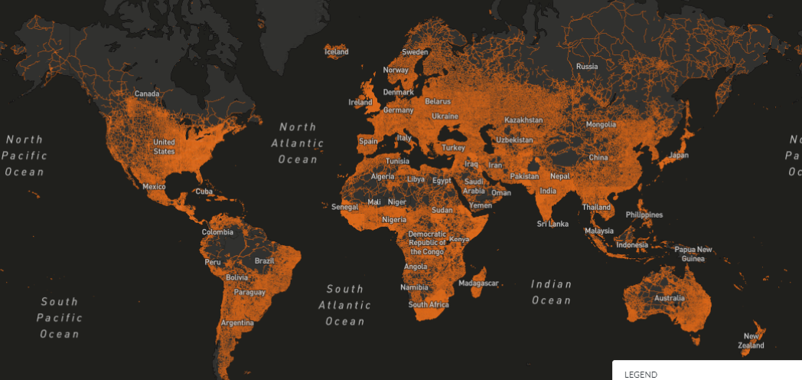
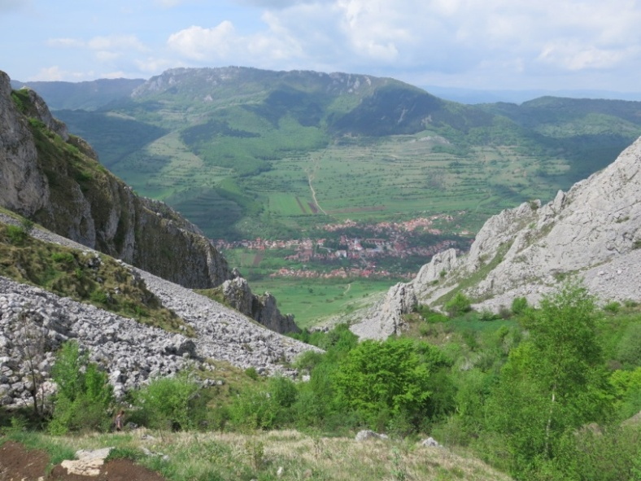
Grey infrastructure ©ResourceWatch
Green Infrastructure vs. Grey Infrastructure
Notes:
Ecocorridors vs transport infrastructure
The focus is clearly on the Carpathians, but we are reaching out to other countries of the EUSDR

Slide 5
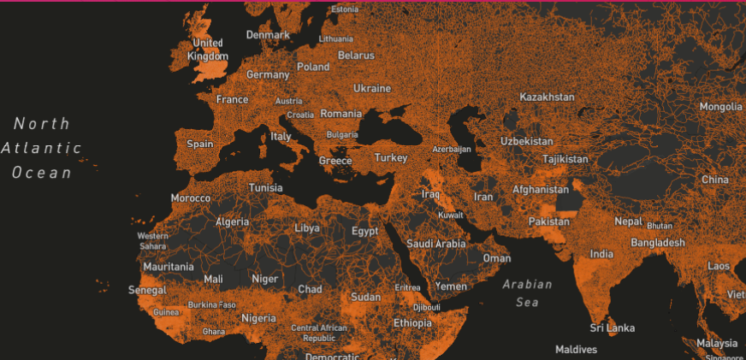
Green Infrastructure vs. Grey Infrastructure
Notes:
Ecocorridors vs transport infrastructure
The focus is clearly on the Carpathians, but we are reaching out to other countries of the EUSDR

Slide 6
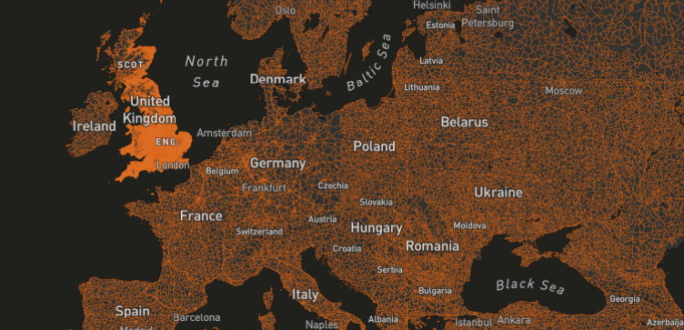
Green Infrastructure vs. Grey Infrastructure
Notes:
Ecocorridors vs transport infrastructure
The focus is clearly on the Carpathians, but we are reaching out to other countries of the EUSDR

Slide 7
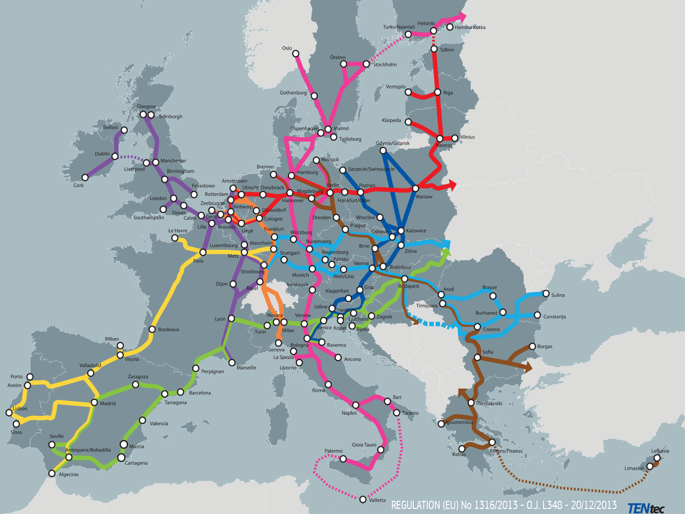
Trans-European Network - Transportation
TEN-T network
Main transportation corridors
http://ec.europa.eu/transport/infrastructure/tentec/tentec-portal/map/maps.html

Slide 8
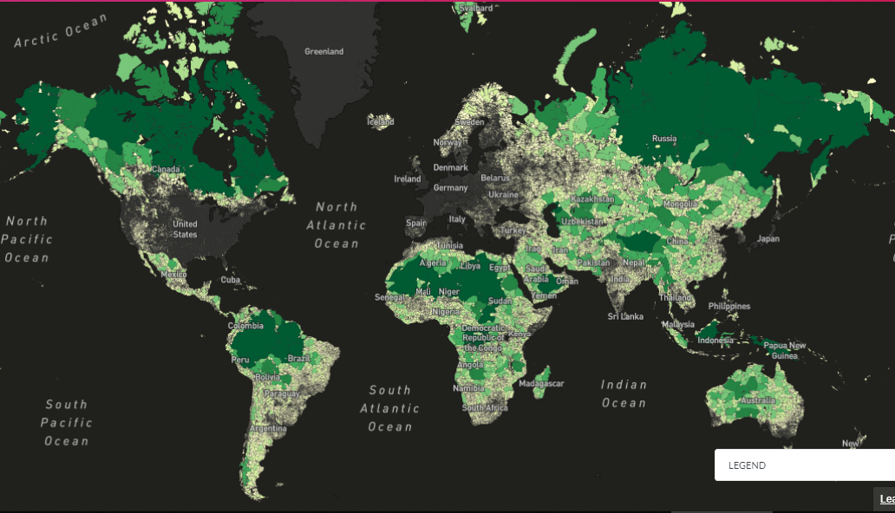
Green and Grey infrastructure ©ResourceWatch
Notes:
Ecocorridors vs transport infrastructure
The focus is clearly on the Carpathians, but we are reaching out to other countries of the EUSDR

Slide 9
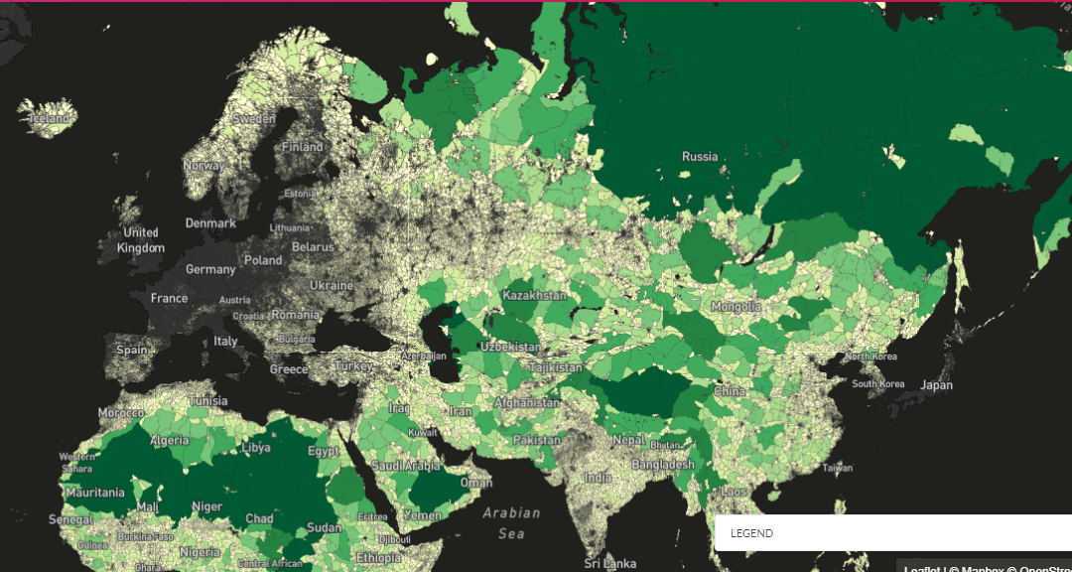
Notes:
Ecocorridors vs transport infrastructure
The focus is clearly on the Carpathians, but we are reaching out to other countries of the EUSDR

Slide 10
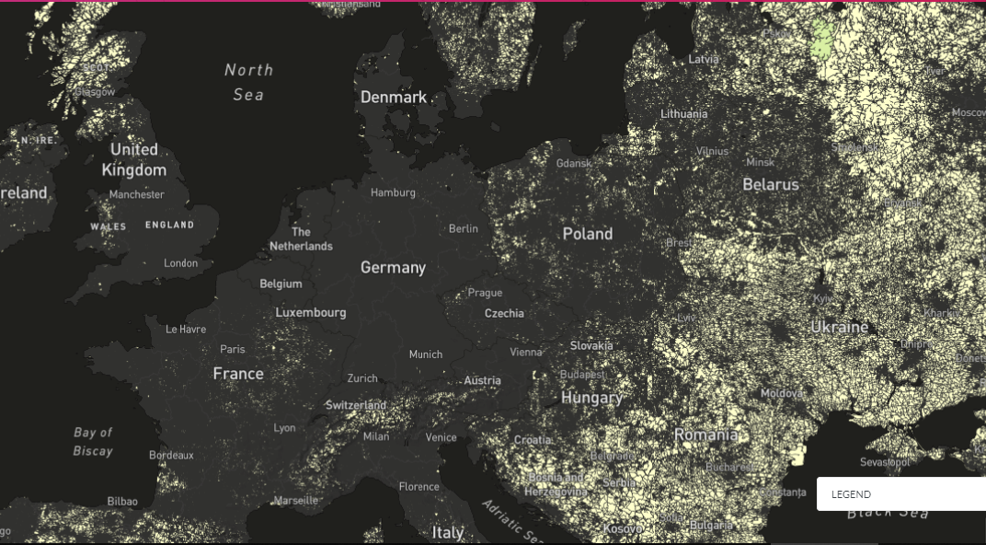
Notes:
Ecocorridors vs transport infrastructure
The focus is clearly on the Carpathians, but we are reaching out to other countries of the EUSDR

Slide 11
Threts
Infrastructure development
Fragmentation of habitats
Loosing ecosystem services
Decreasing biodiversity
Climte change
Lack of cooperation

Slide 12
Threts
Infrastructure development
Fragmentation of habitats
Loosing ecosystem services
Decreasing biodiversity
Climte change
Lack of cooperation
Opportunities
Existing natural assets and willingness to protect them
Long lasting development processes
Ambitious new EU policy

Slide 13
Flowchart of ConnectGreen Project
Methodology for field work
Monitoring & data collection
Field work in pilot areas
Embed data
To habitat suitability model
To CCIBIS.org
Embed model to on-going processes
national spatial planning process
International strategic cooperation
Inter-sectoral communication
Meetings, trainings, strategies

Slide 14
Flowchart of ConnectGreen Project
Methodology for field work
Monitoring & data collection
Field work in pilot areas
Embed data
To habitat suitability model
To CCIBIS.org
Embed model to on-going processes
national spatial planning process
International strategic cooperation
Inter-sectoral communication
Meetings, trainings, strategies

Slide 15
Flowchart of ConnectGreen Project
Methodology for field work
Monitoring & data collection
Field work in pilot areas
Embed data
To habitat suitability model
To CCIBIS.org
Embed model to on-going processes
national spatial planning process
International strategic cooperation
Inter-sectoral communication
Meetings, trainings, strategies

Slide 16
Flowchart of ConnectGreen Project
Methodology for field work
Monitoring & data collection
Field work in pilot areas
Embed data
To habitat suitability model
To CCIBIS.org
Embed model to on-going processes
national spatial planning process
International strategic cooperation
Inter-sectoral communication
Meetings, trainings, strategies

Slide 17
Flowchart of ConnectGreen Project
Methodology for field work
Monitoring & data collection
Field work in pilot areas
Embed data
To habitat suitability model
To CCIBIS.org
Embed model to on-going processes
national spatial planning process
International strategic cooperation
Inter-sectoral communication
Meetings, trainings, strategies

Slide 18
The methodology Methodology for the identification of migration corridors for large carnivores in the Carpathian Countries Okániková, Z., Záhorec,L, Kluchová, A., Strnad, M., Romportl, D., Janák, M., and Hlaváč, V. (2019).
Identification of ecological corridors
Reconciliation of nature conservation and spatial planning practices,
Capacity building of protected areas' staff
Development of management measures by using active stakeholder engagement processes.
Notes:
AF: „The methodology will be the basis to identify eco-corridors in the Carpathians by using large carnivores (brown bear, grey wolf and eurasian lynx) as umbrella species. There will be one harmonized methodology for the regional use, which will be adapted to each countries needs.
It will be thus used on both local (pilot areas) and national as well as at a regional level.
The general methodology will be embedded as part of the Strategy into the frame of the Carpathian Convention thorugh its parties“

Slide 19
Flowchart of ConnectGreen Project
Methodology for field work
Monitoring & data collection
Field work in pilot areas
Embed data
To habitat suitability model
To CCIBIS.org
Embed model to on-going processes
national spatial planning process
International strategic cooperation
Support intersectoral communication
Meetings, learning package, strategy

Slide 20
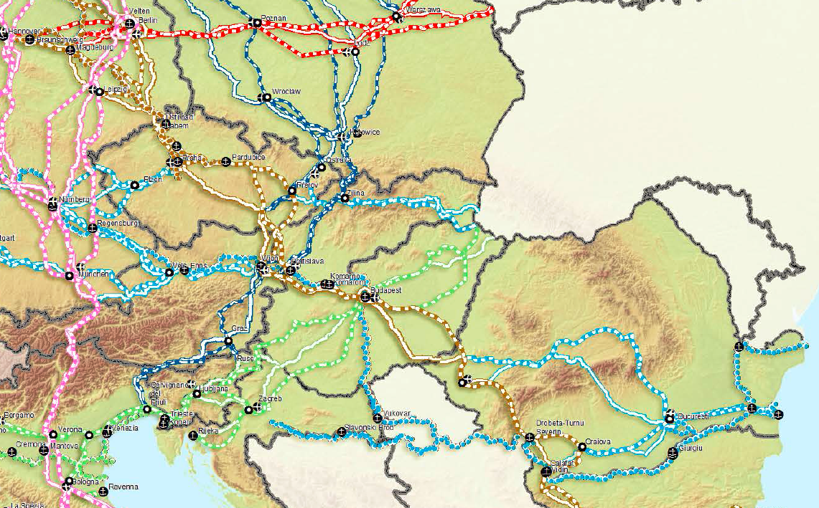
Pilot Areas
Piatra Craiului National Park (RO)
Apuseni-SW Carpathians (RO)/ National Park Djerdap (SB);
Western Carpathians (CZ-SK)
Bükk National Park (HU)/ Cerová vrchovina Protected Landscape Area (SK)
Notes:
20

Slide 21
Flowchart of ConnectGreen Project
Methodology for field work
Monitoring & data collection
Field work in pilot areas
Embed data
To habitat suitability model
To CCIBIS.org
Embed model to on-going processes
national spatial planning process
International strategic cooperation
Support intersectoral communication
Meetings, learning package, strategy

Slide 22
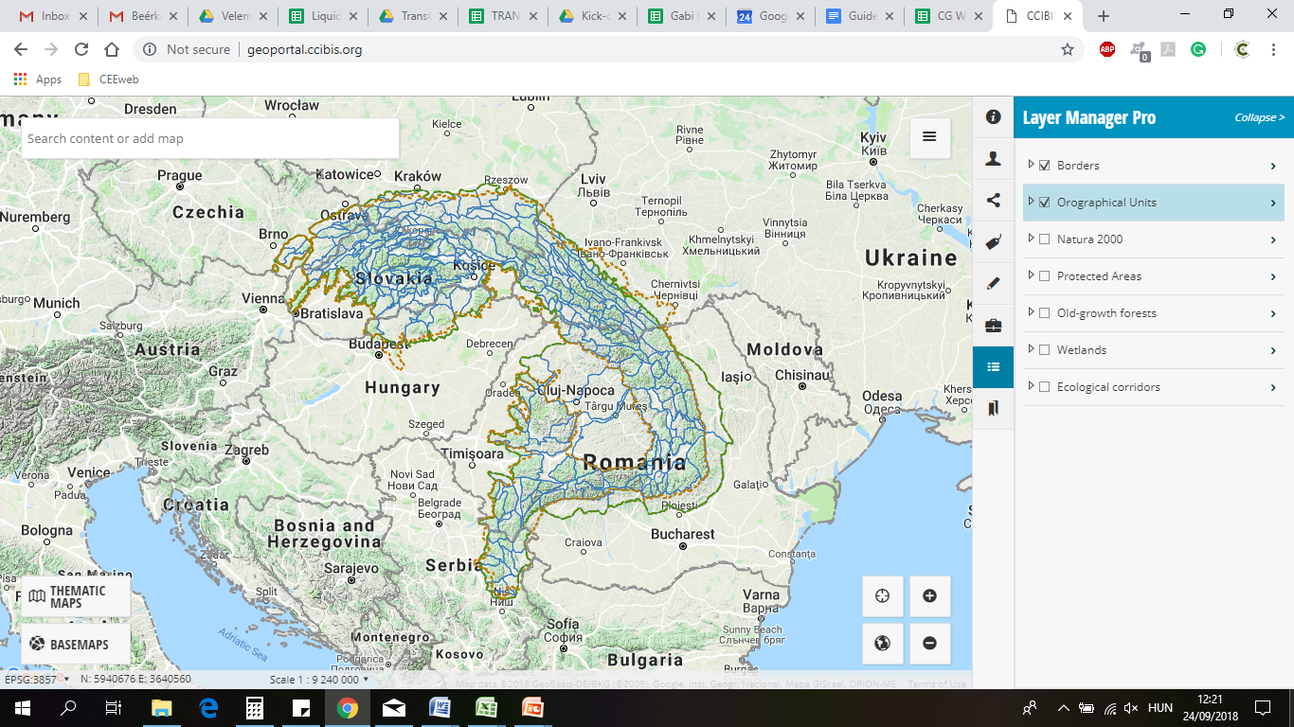
Notes:
Shall I delete this slide?
22

Slide 23
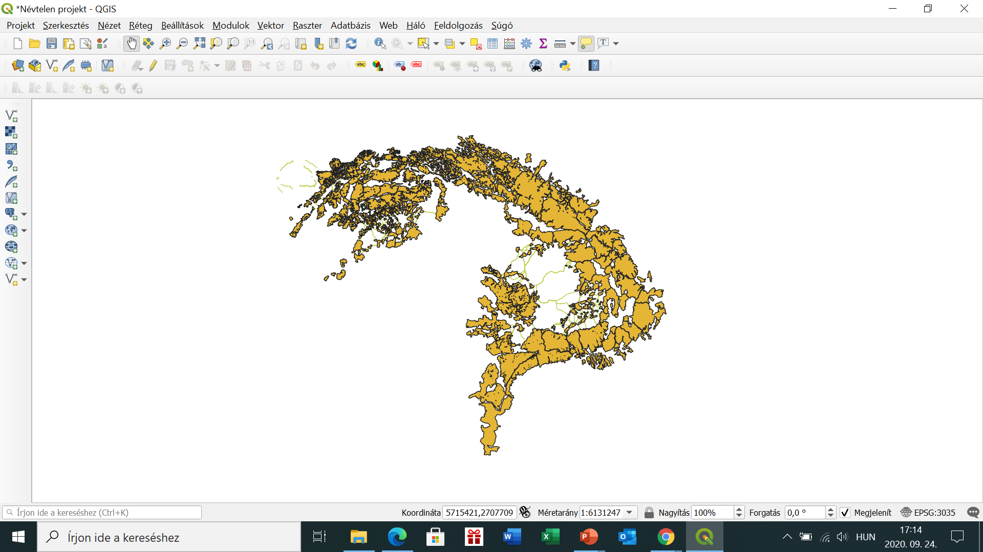
Habitat suitability model

Slide 25
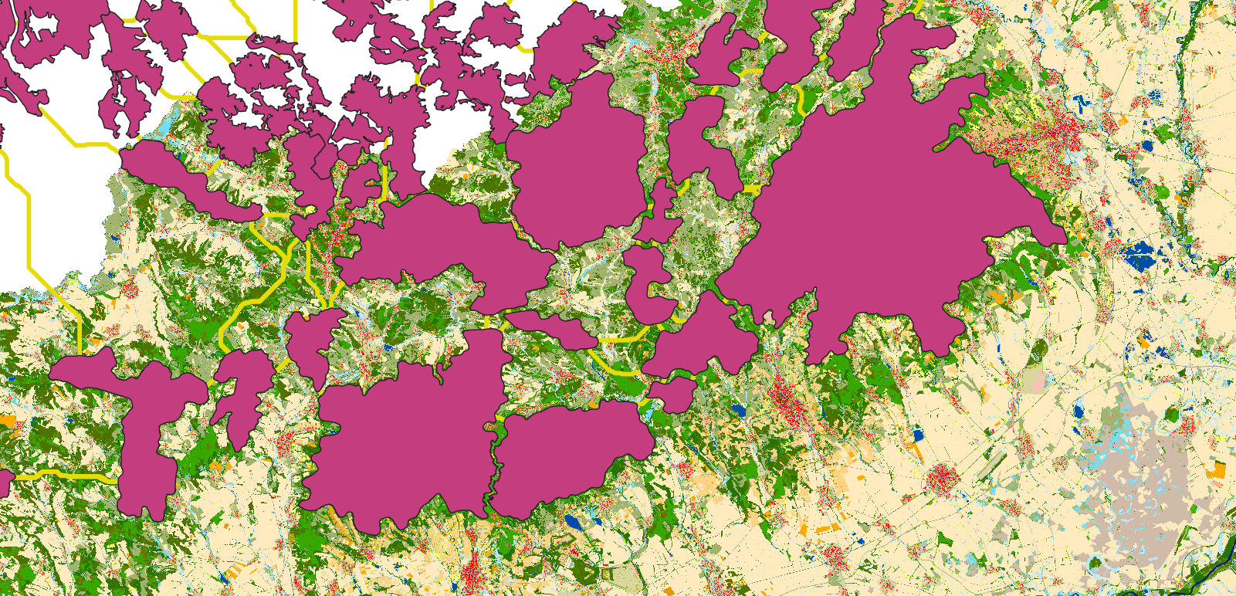

Slide 26
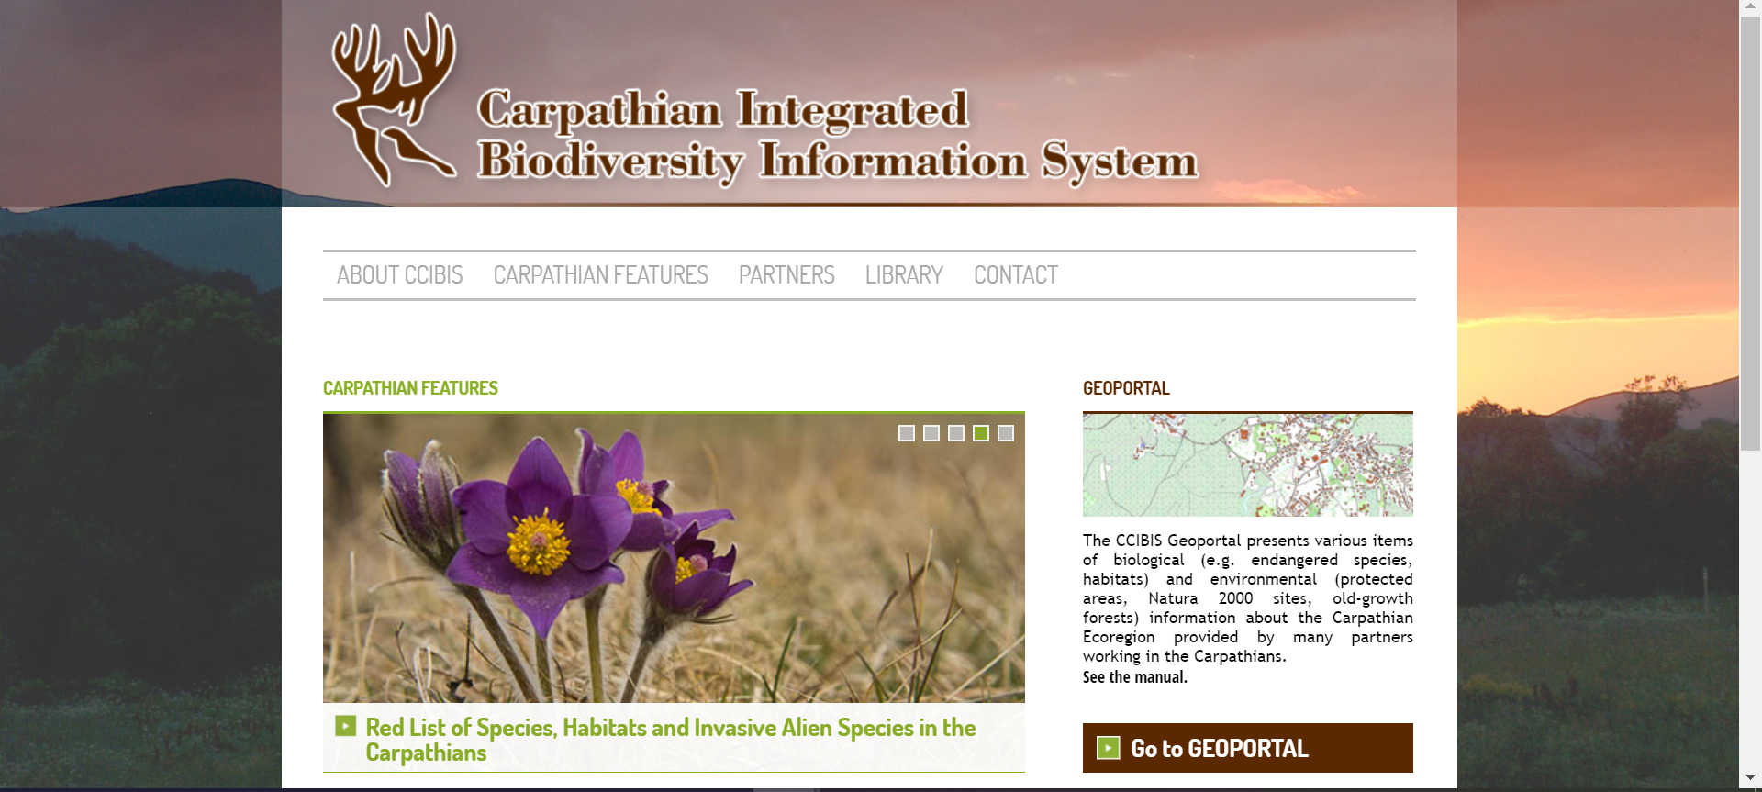
CCIBIS.ORG
Carpathian Countries Integrated Biodiversity Information System
http://ccibis.org/#&panel1-4
Notes:
Shall I delete this slide?
26

Slide 27
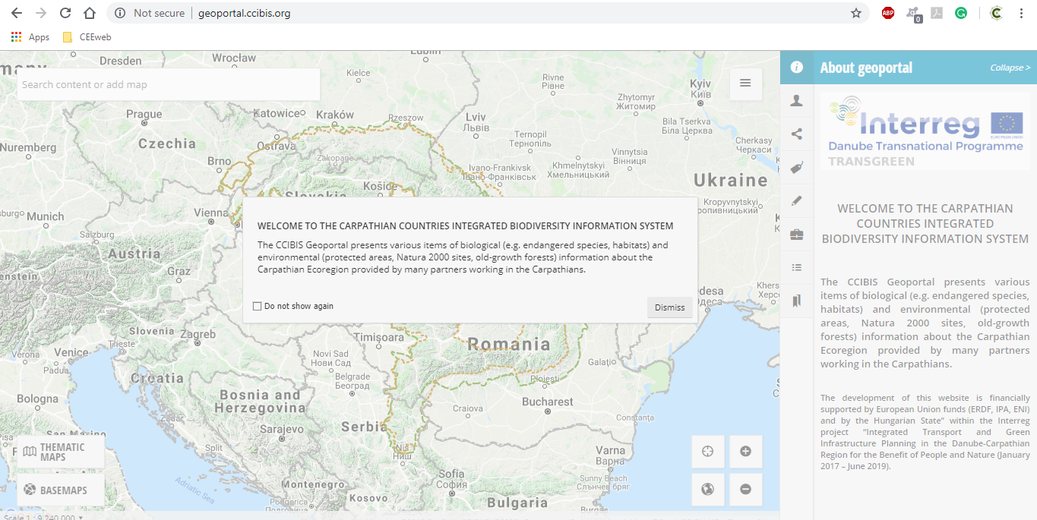
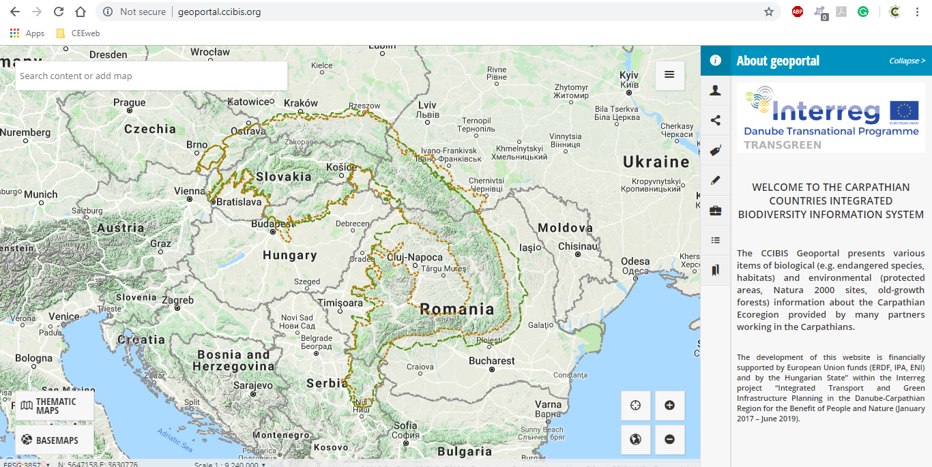
Notes:
Shall I delete this slide?
27

Slide 28
Notes:
Shall I delete this slide?
28

Slide 29
Notes:
Shall I delete this slide?
29

Slide 30
Notes:
Shall I delete this slide?
30

Slide 31
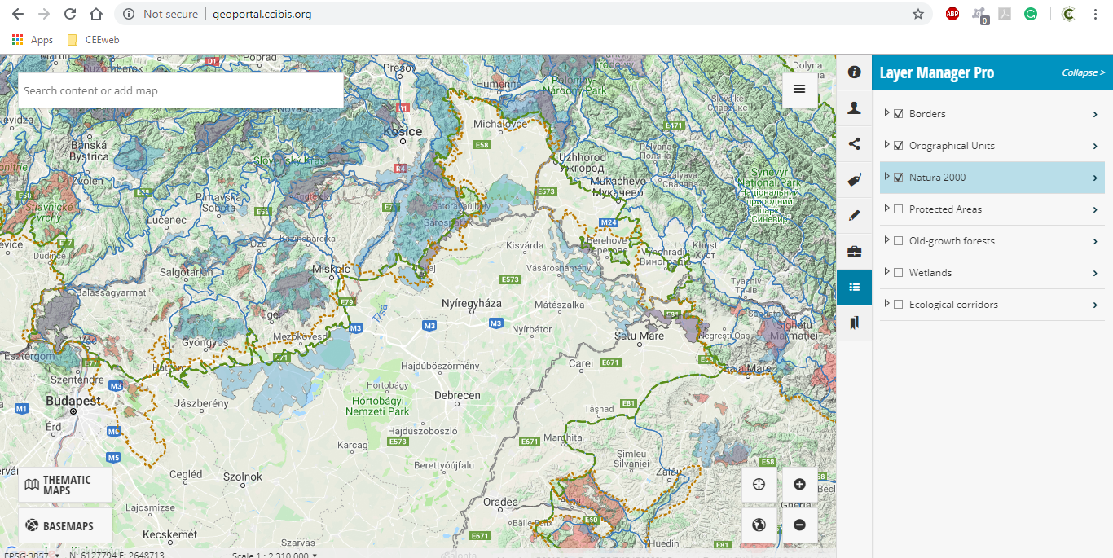
TRANSGREEN
Notes:
Shall I delete this slide?
31

Slide 32
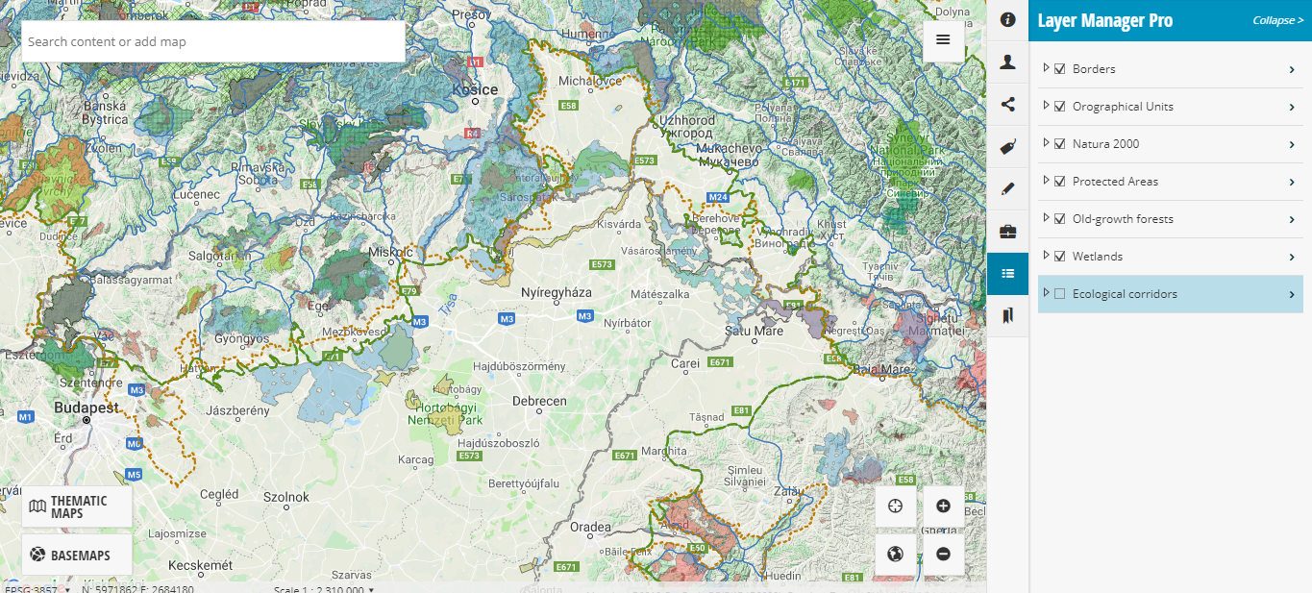
TRANSGREEN
Notes:
Shall I delete this slide?
32

Slide 33
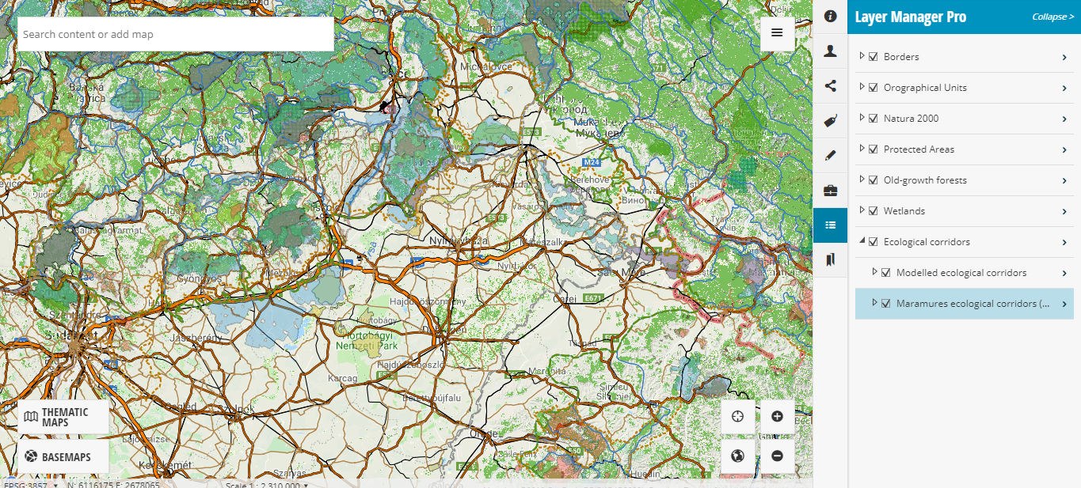
TRANSGREEN
Notes:
Shall I delete this slide?
33

Slide 34
Flowchart of ConnectGreen Project
Methodology for field work
Monitoring & data collection
Field work in pilot areas
Embed data
To habitat suitability model
To CCIBIS.org
Embed model to on-going processes
national spatial planning process
International strategic cooperation
Support intersectoral communication
Meetings, learning package, strategy

Slide 35
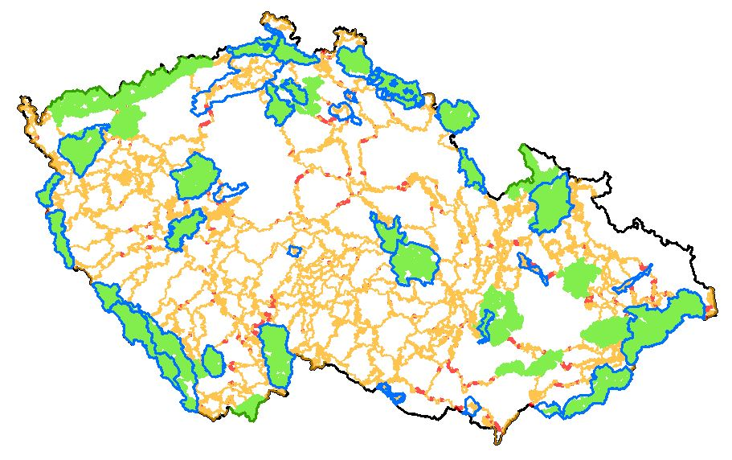
Core ares / corridors / critical zones in CZ
Protected Landscape Areas
National parks
By Martin Strnad

Slide 36
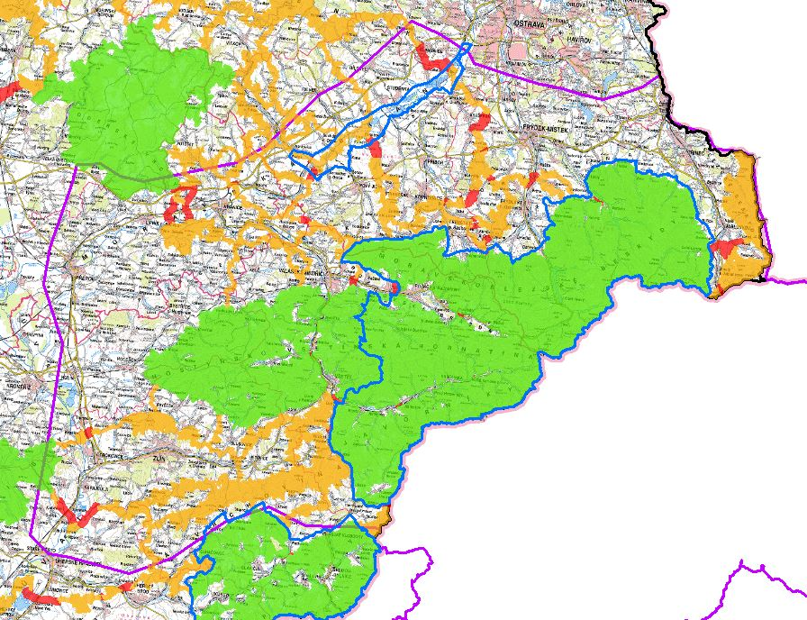
By Martin Strnad

Slide 37
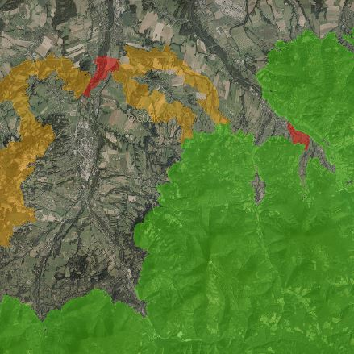
Critical zones delineation
Critical zone in the middle of corridor
Critical zone within core area
By Martin Strnad

Slide 38
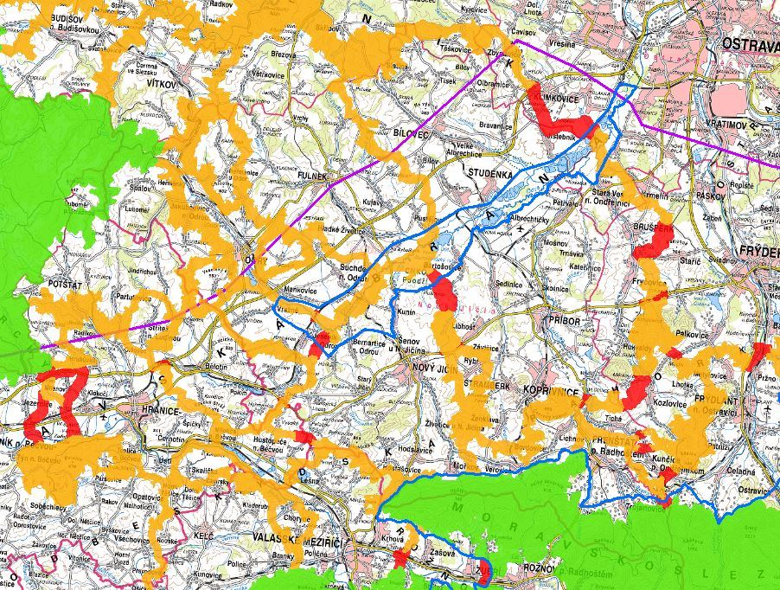
Critical zones in the middle of corridors
By Martin Strnad

Slide 39
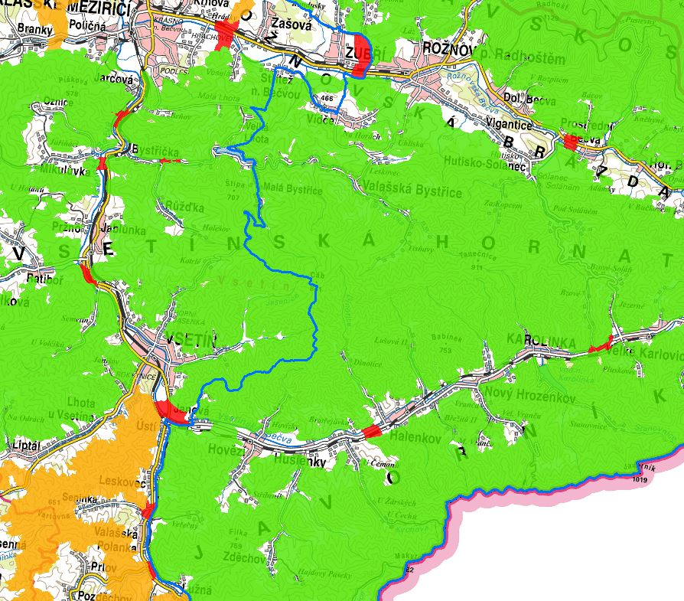
Critical zones within core area
By Martin Strnad

Slide 40
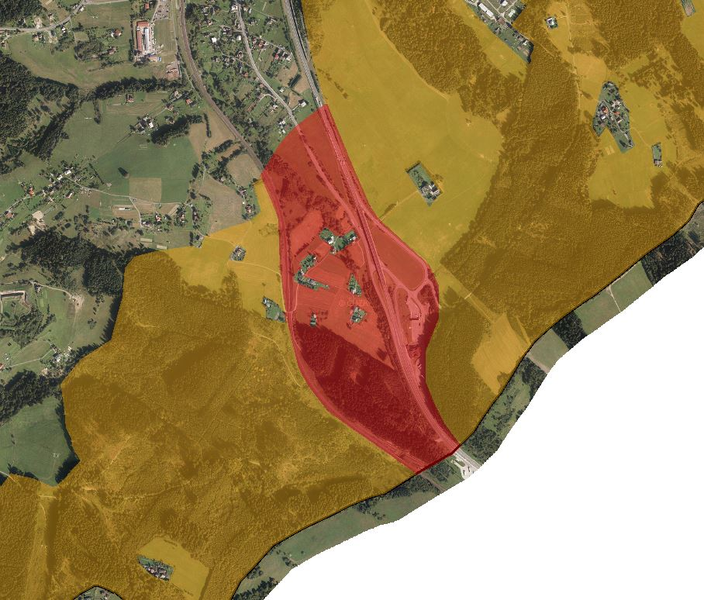
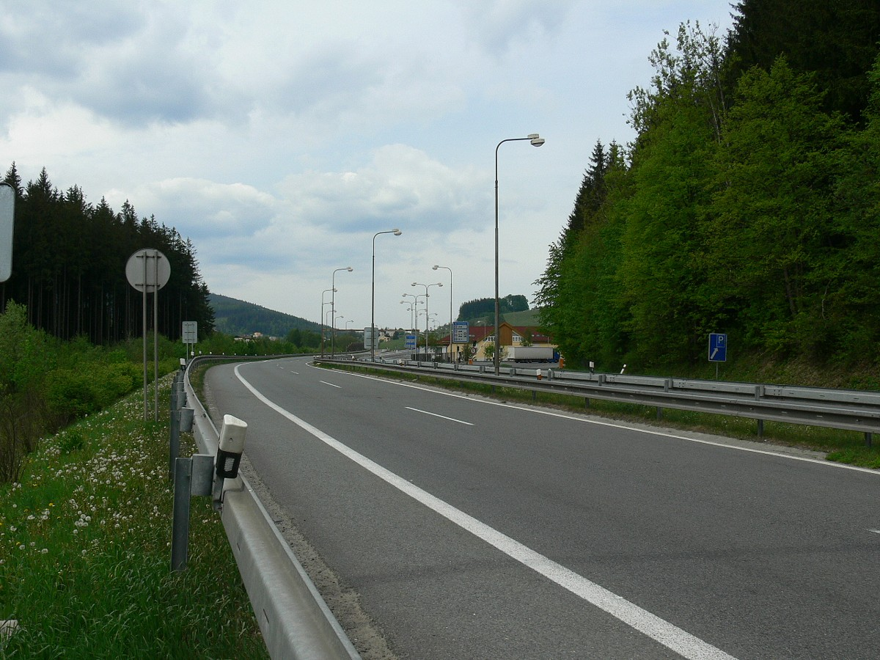
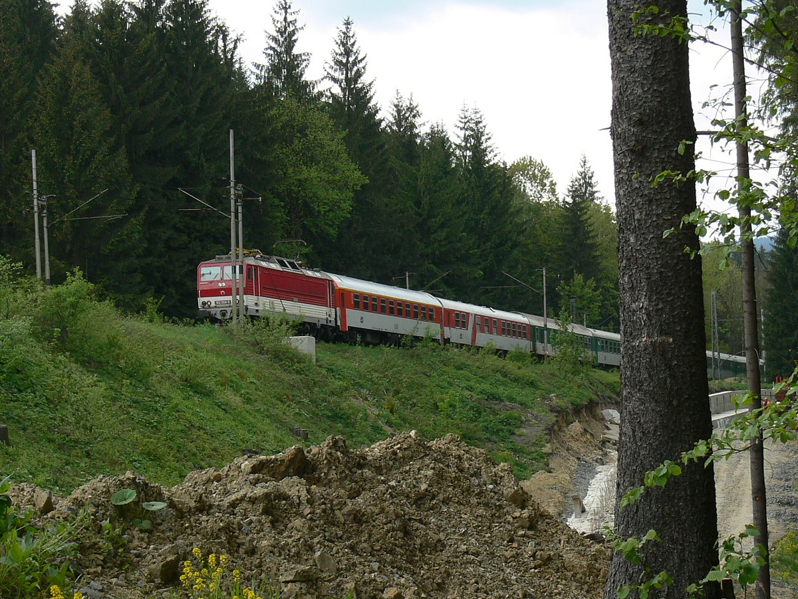
Road I/11 + Railway
By Martin Strnad

Slide 41
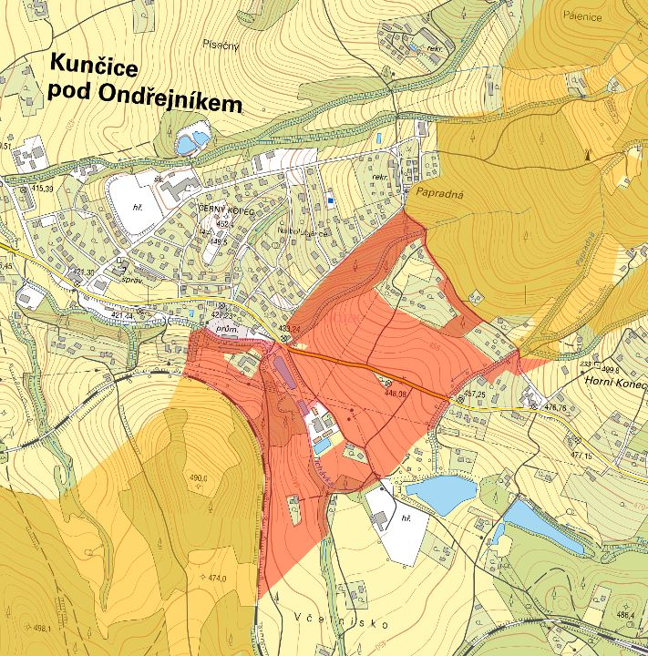
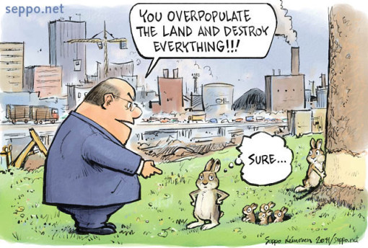
Settlement
By Martin Strnad

Slide 42
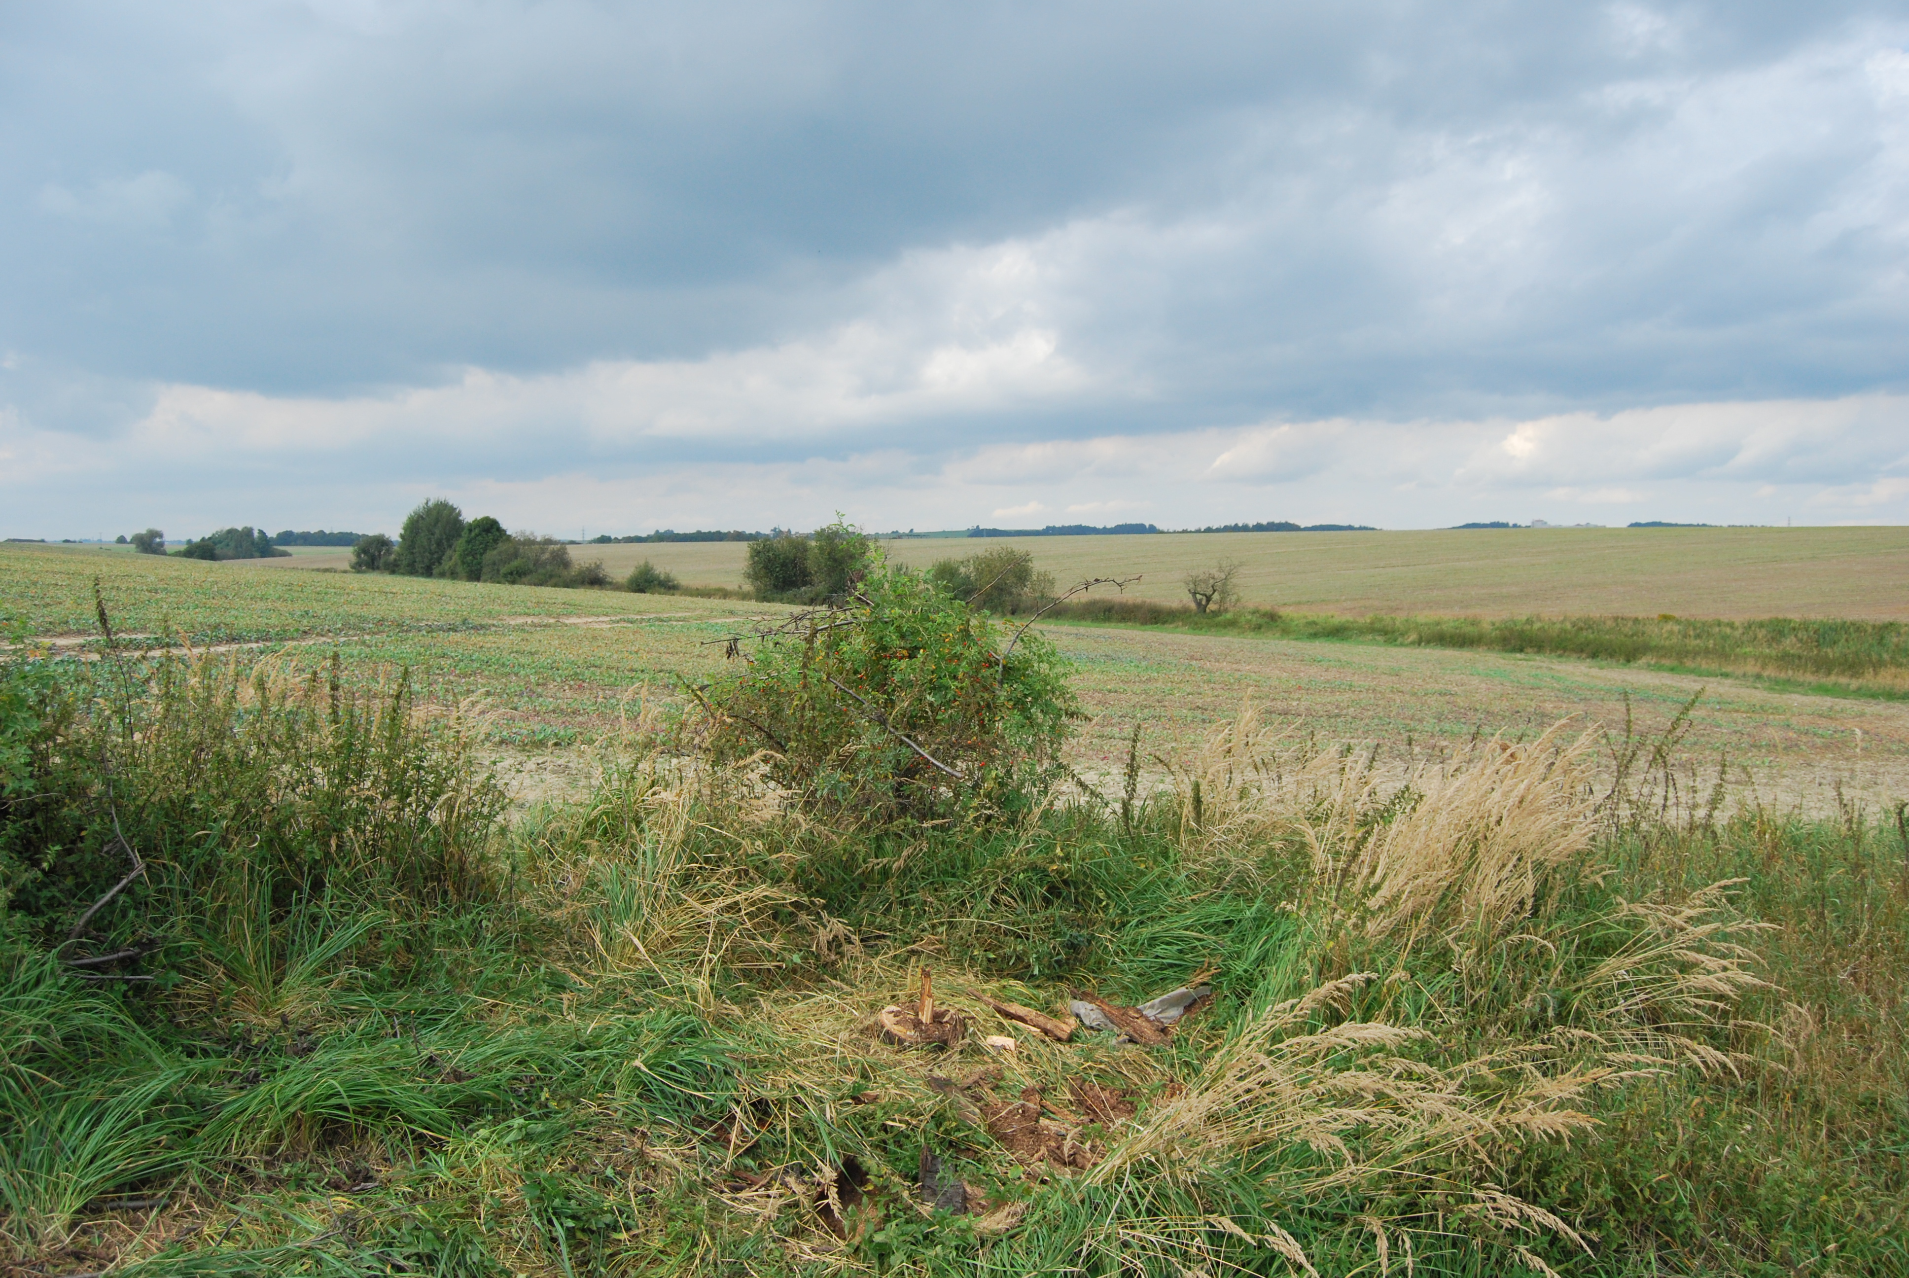
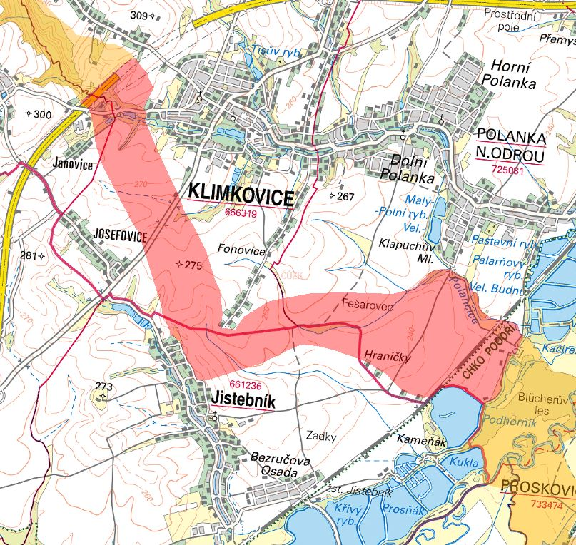
Forest free areas
By Martin Strnad

Slide 43
Flowchart of ConnectGreen Project
Methodology for field work
Monitoring & data collection
Field work in pilot areas
Embed data
To habitat suitability model
To CCIBIS.org
Embed model to on-going processes
national spatial planning process
International strategic cooperation
Support intersectoral communication
Meetings, learning package, strategy

Slide 44
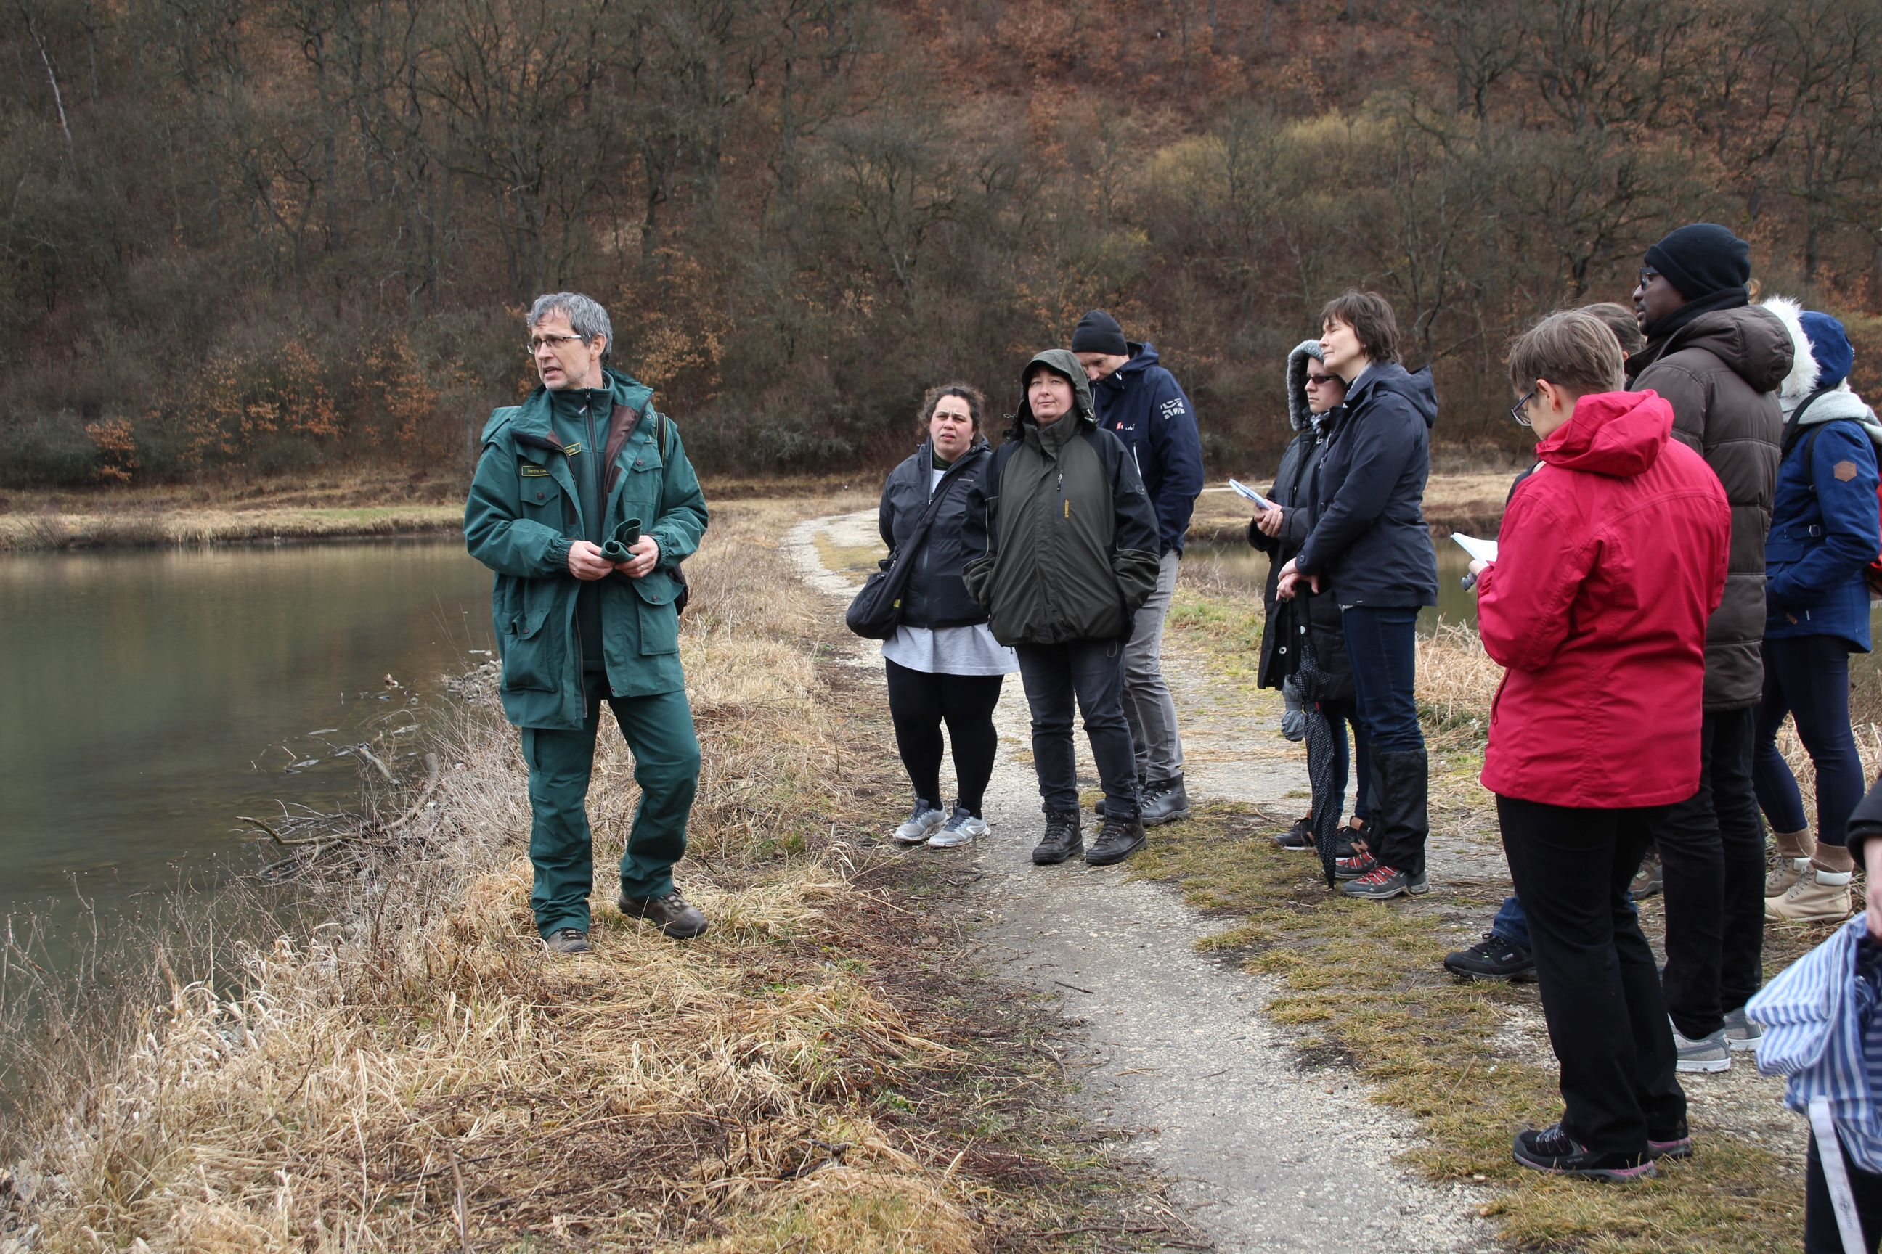
Meetings, field trips, trainings

Slide 45
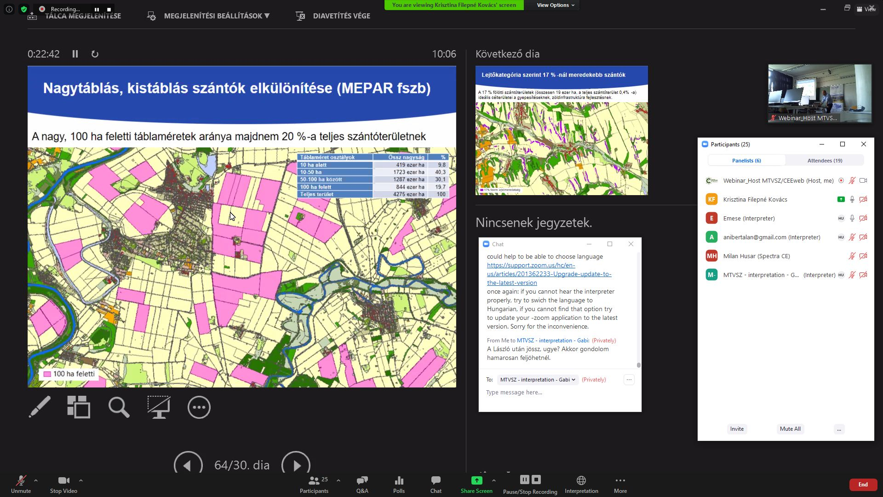
Meetings, field trips, trainings

Slide 46
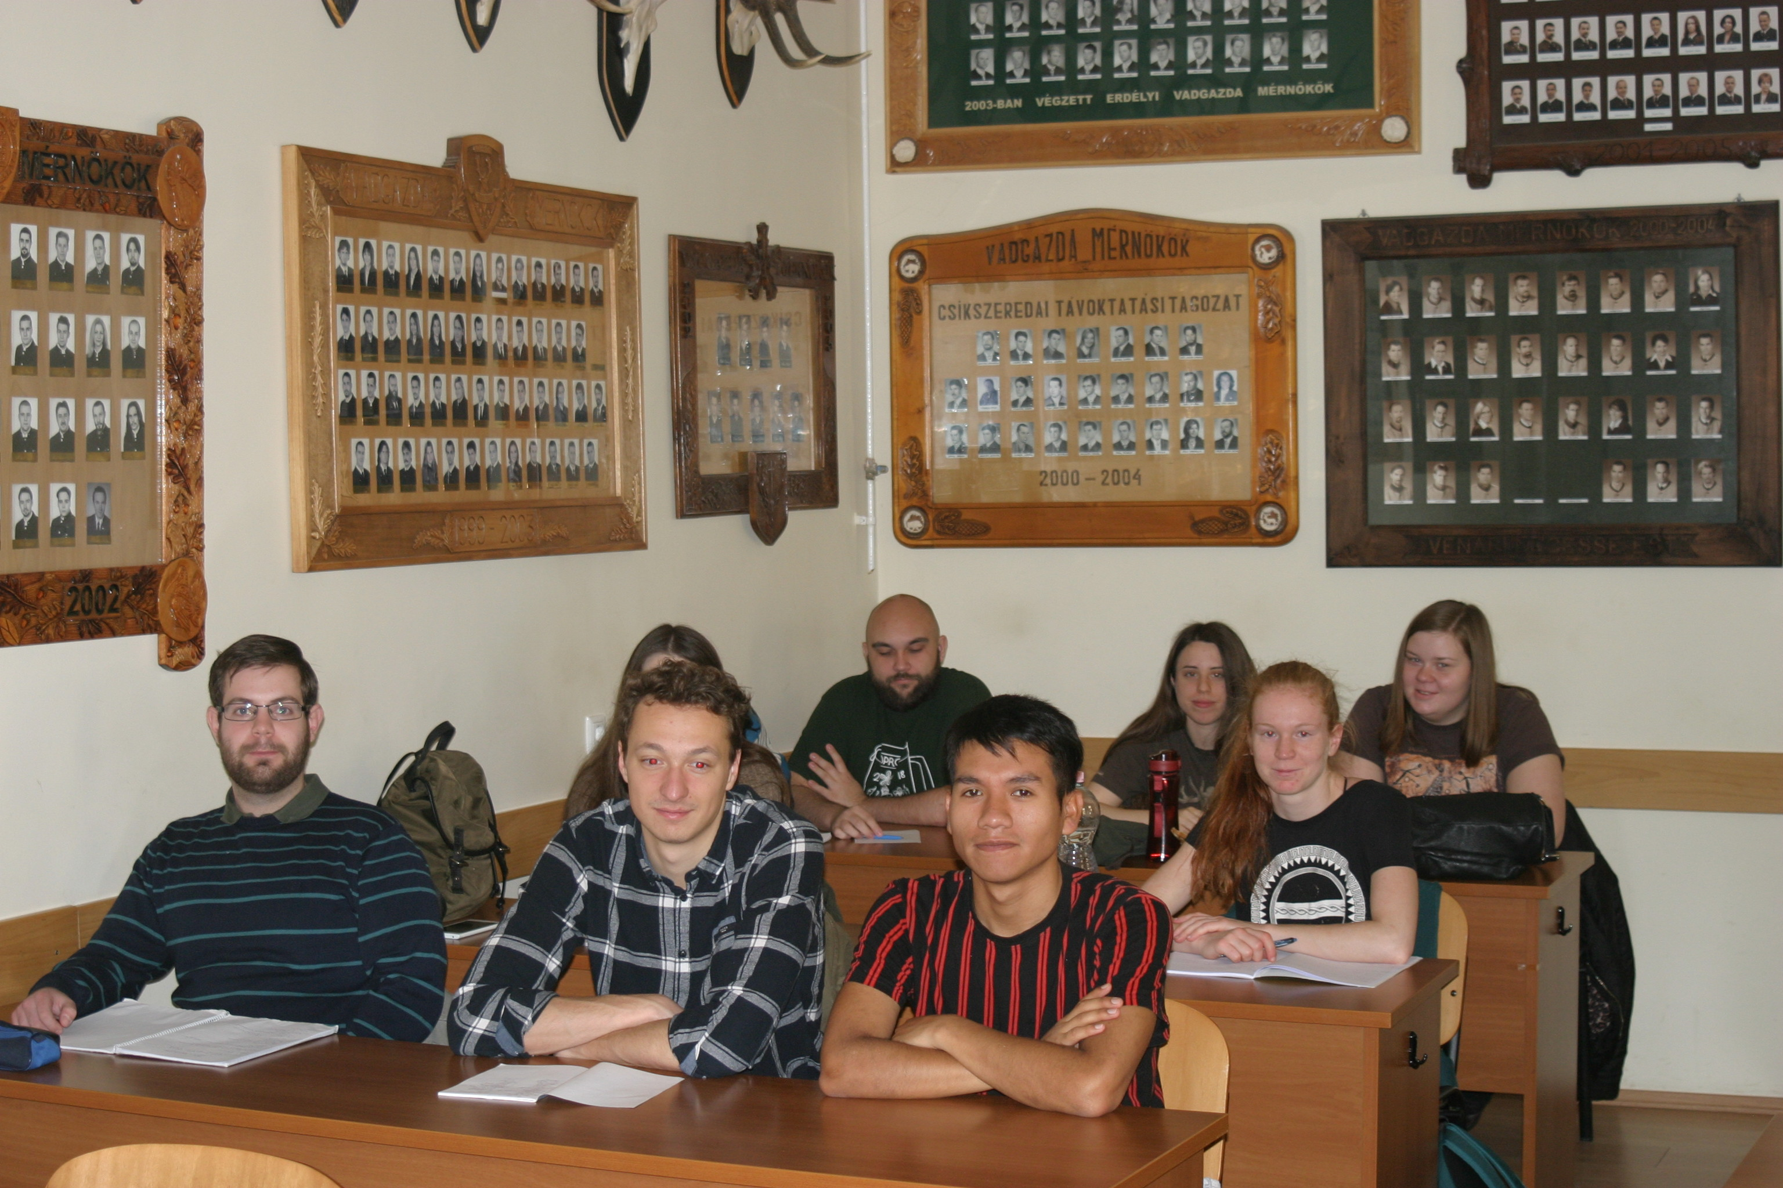
Meetings, field trips, trainings

Slide 47
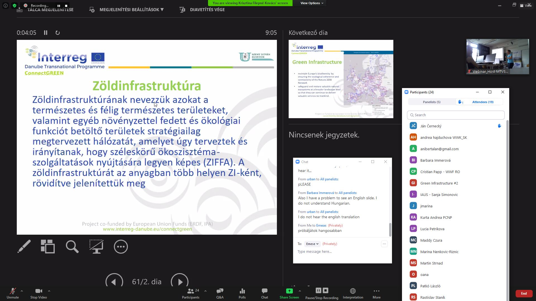
Meetings, field trips, trainings

Slide 48
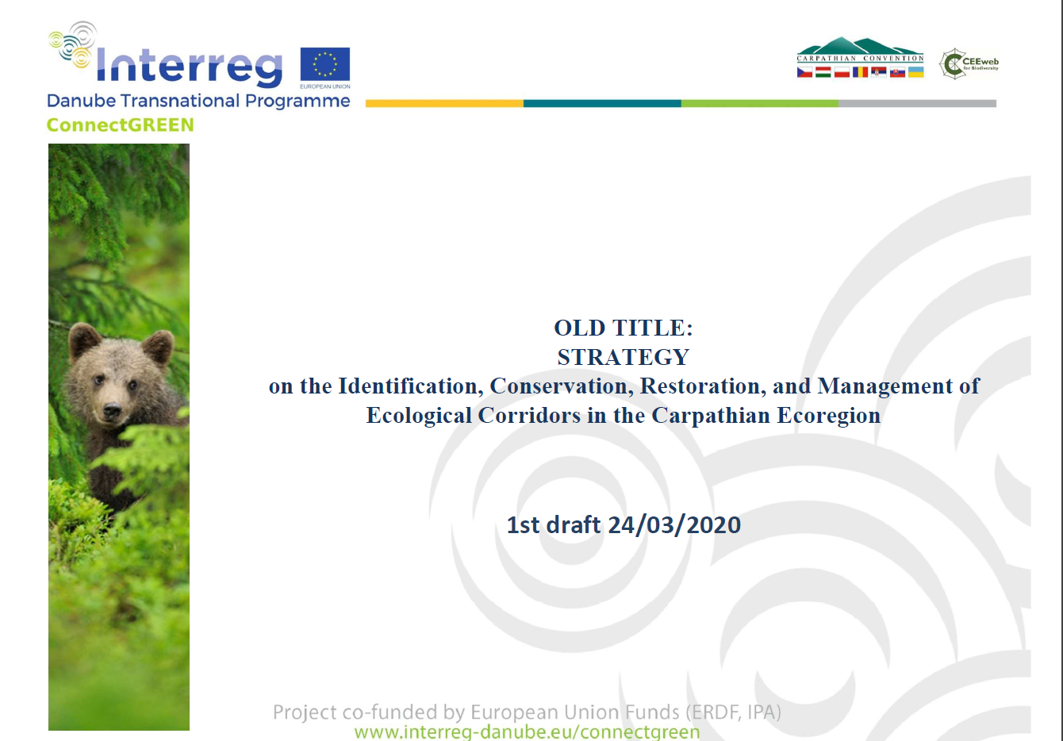
Meetings, field trips, trainings

Slide 49
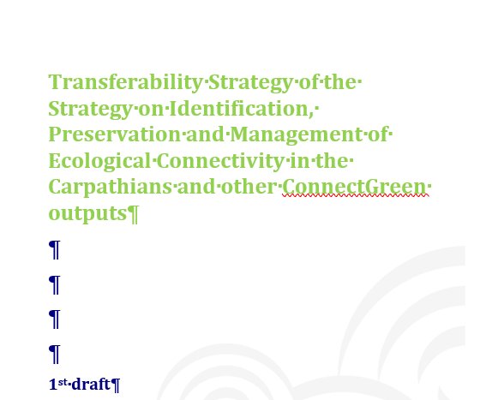
Meetings, field trips, trainings

Slide 50
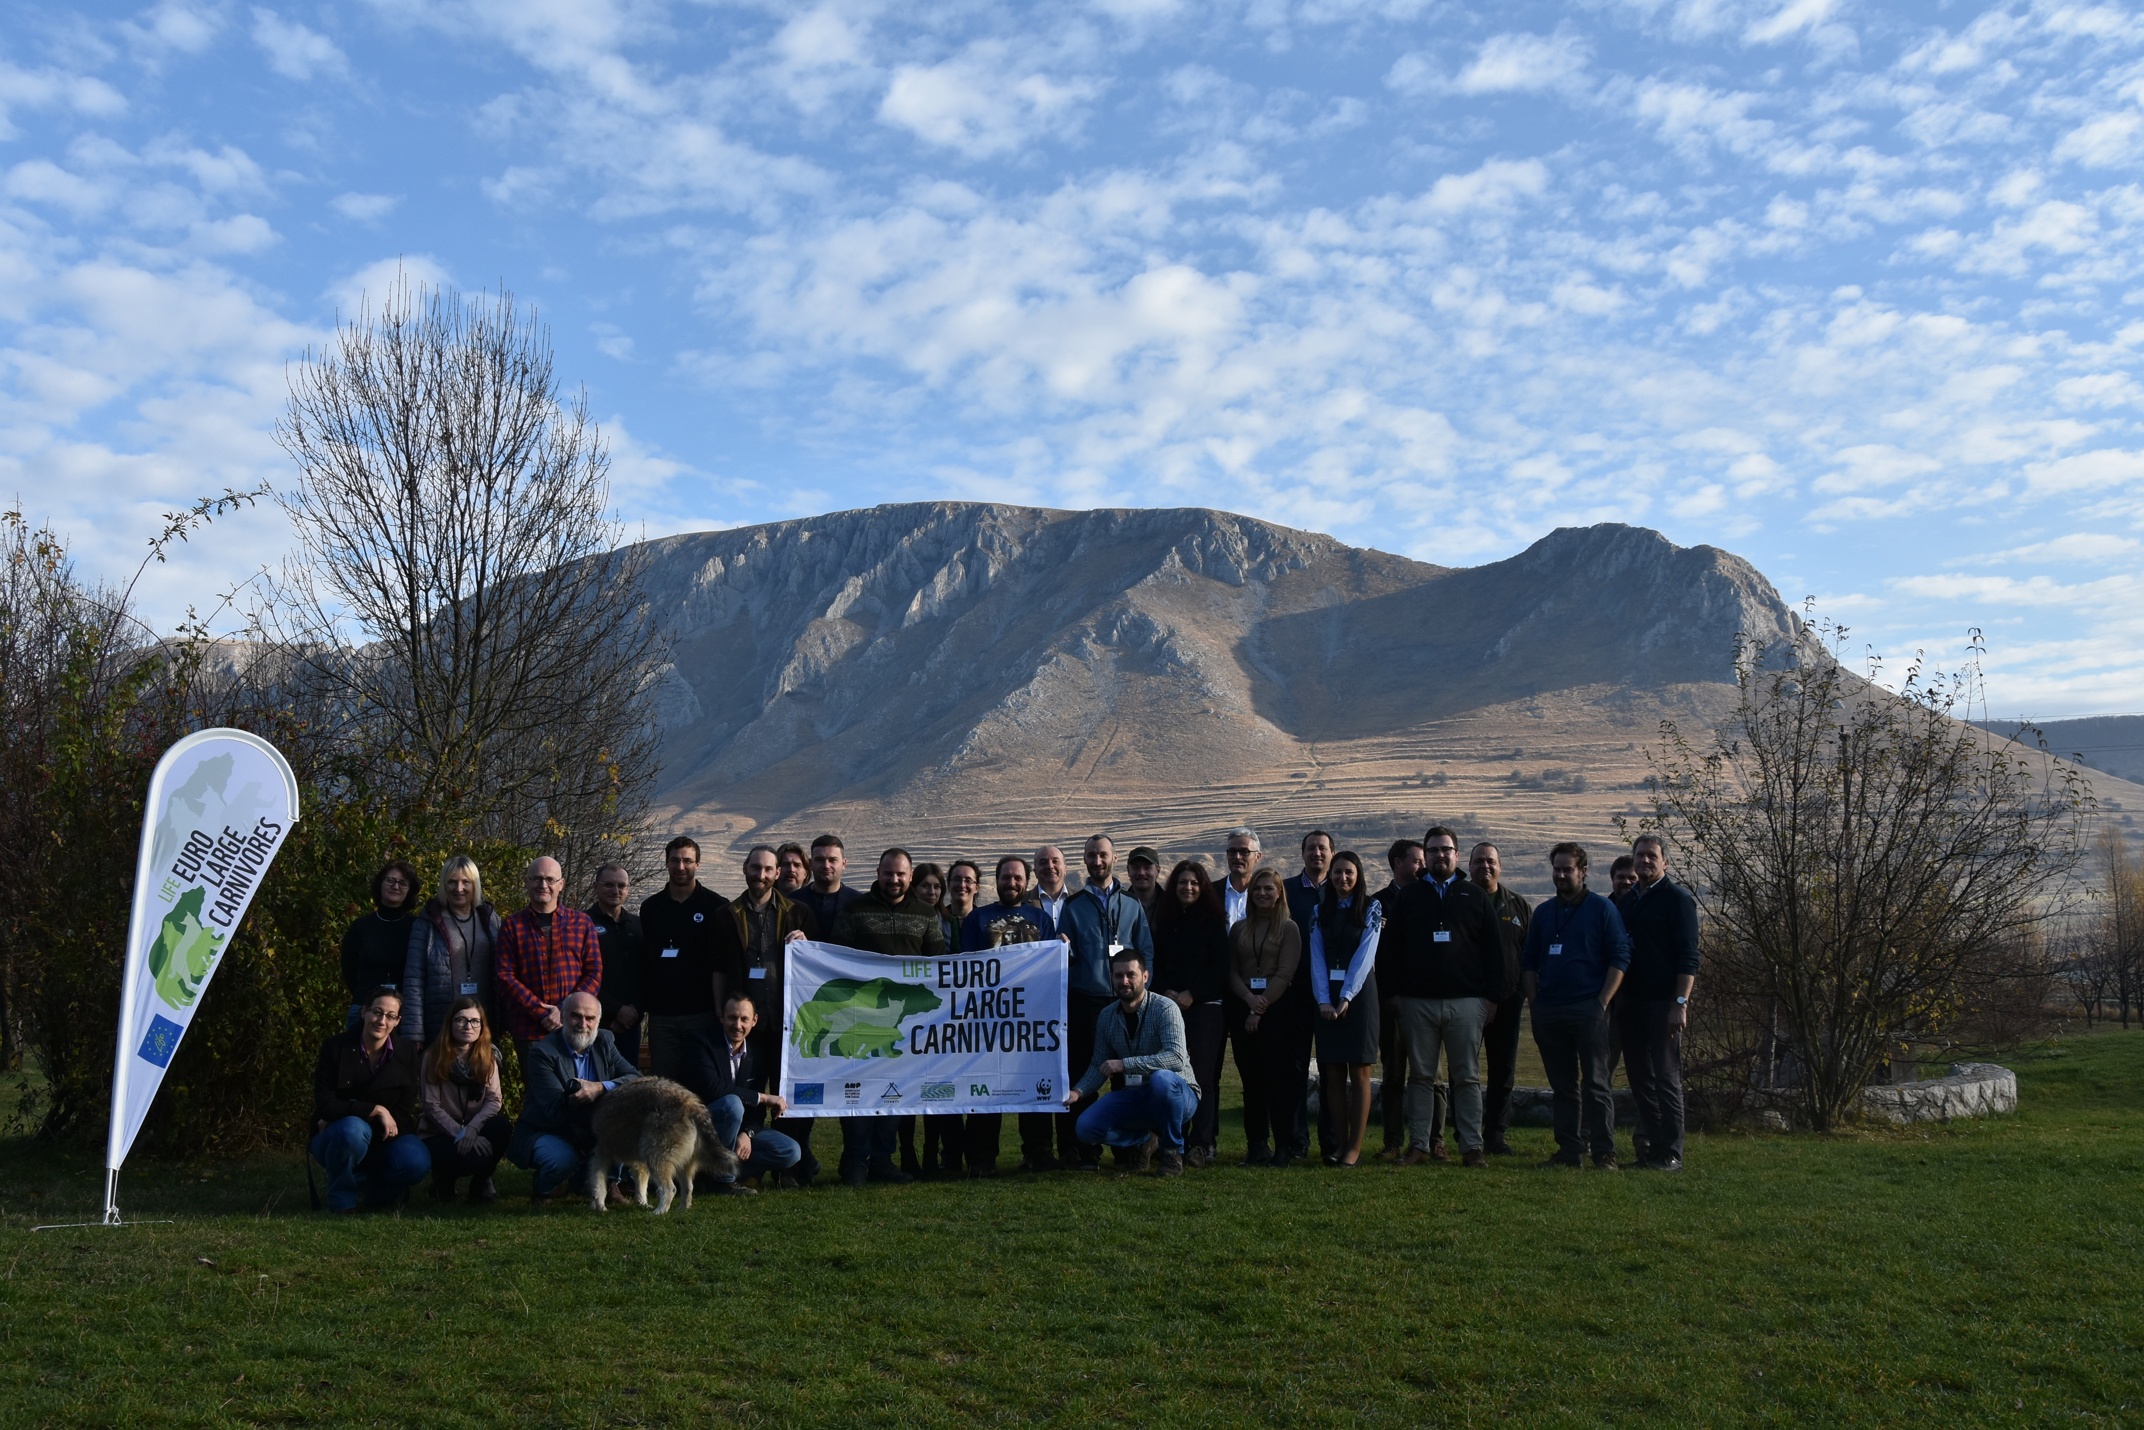
Meetings, field trips, trainings

Slide 51
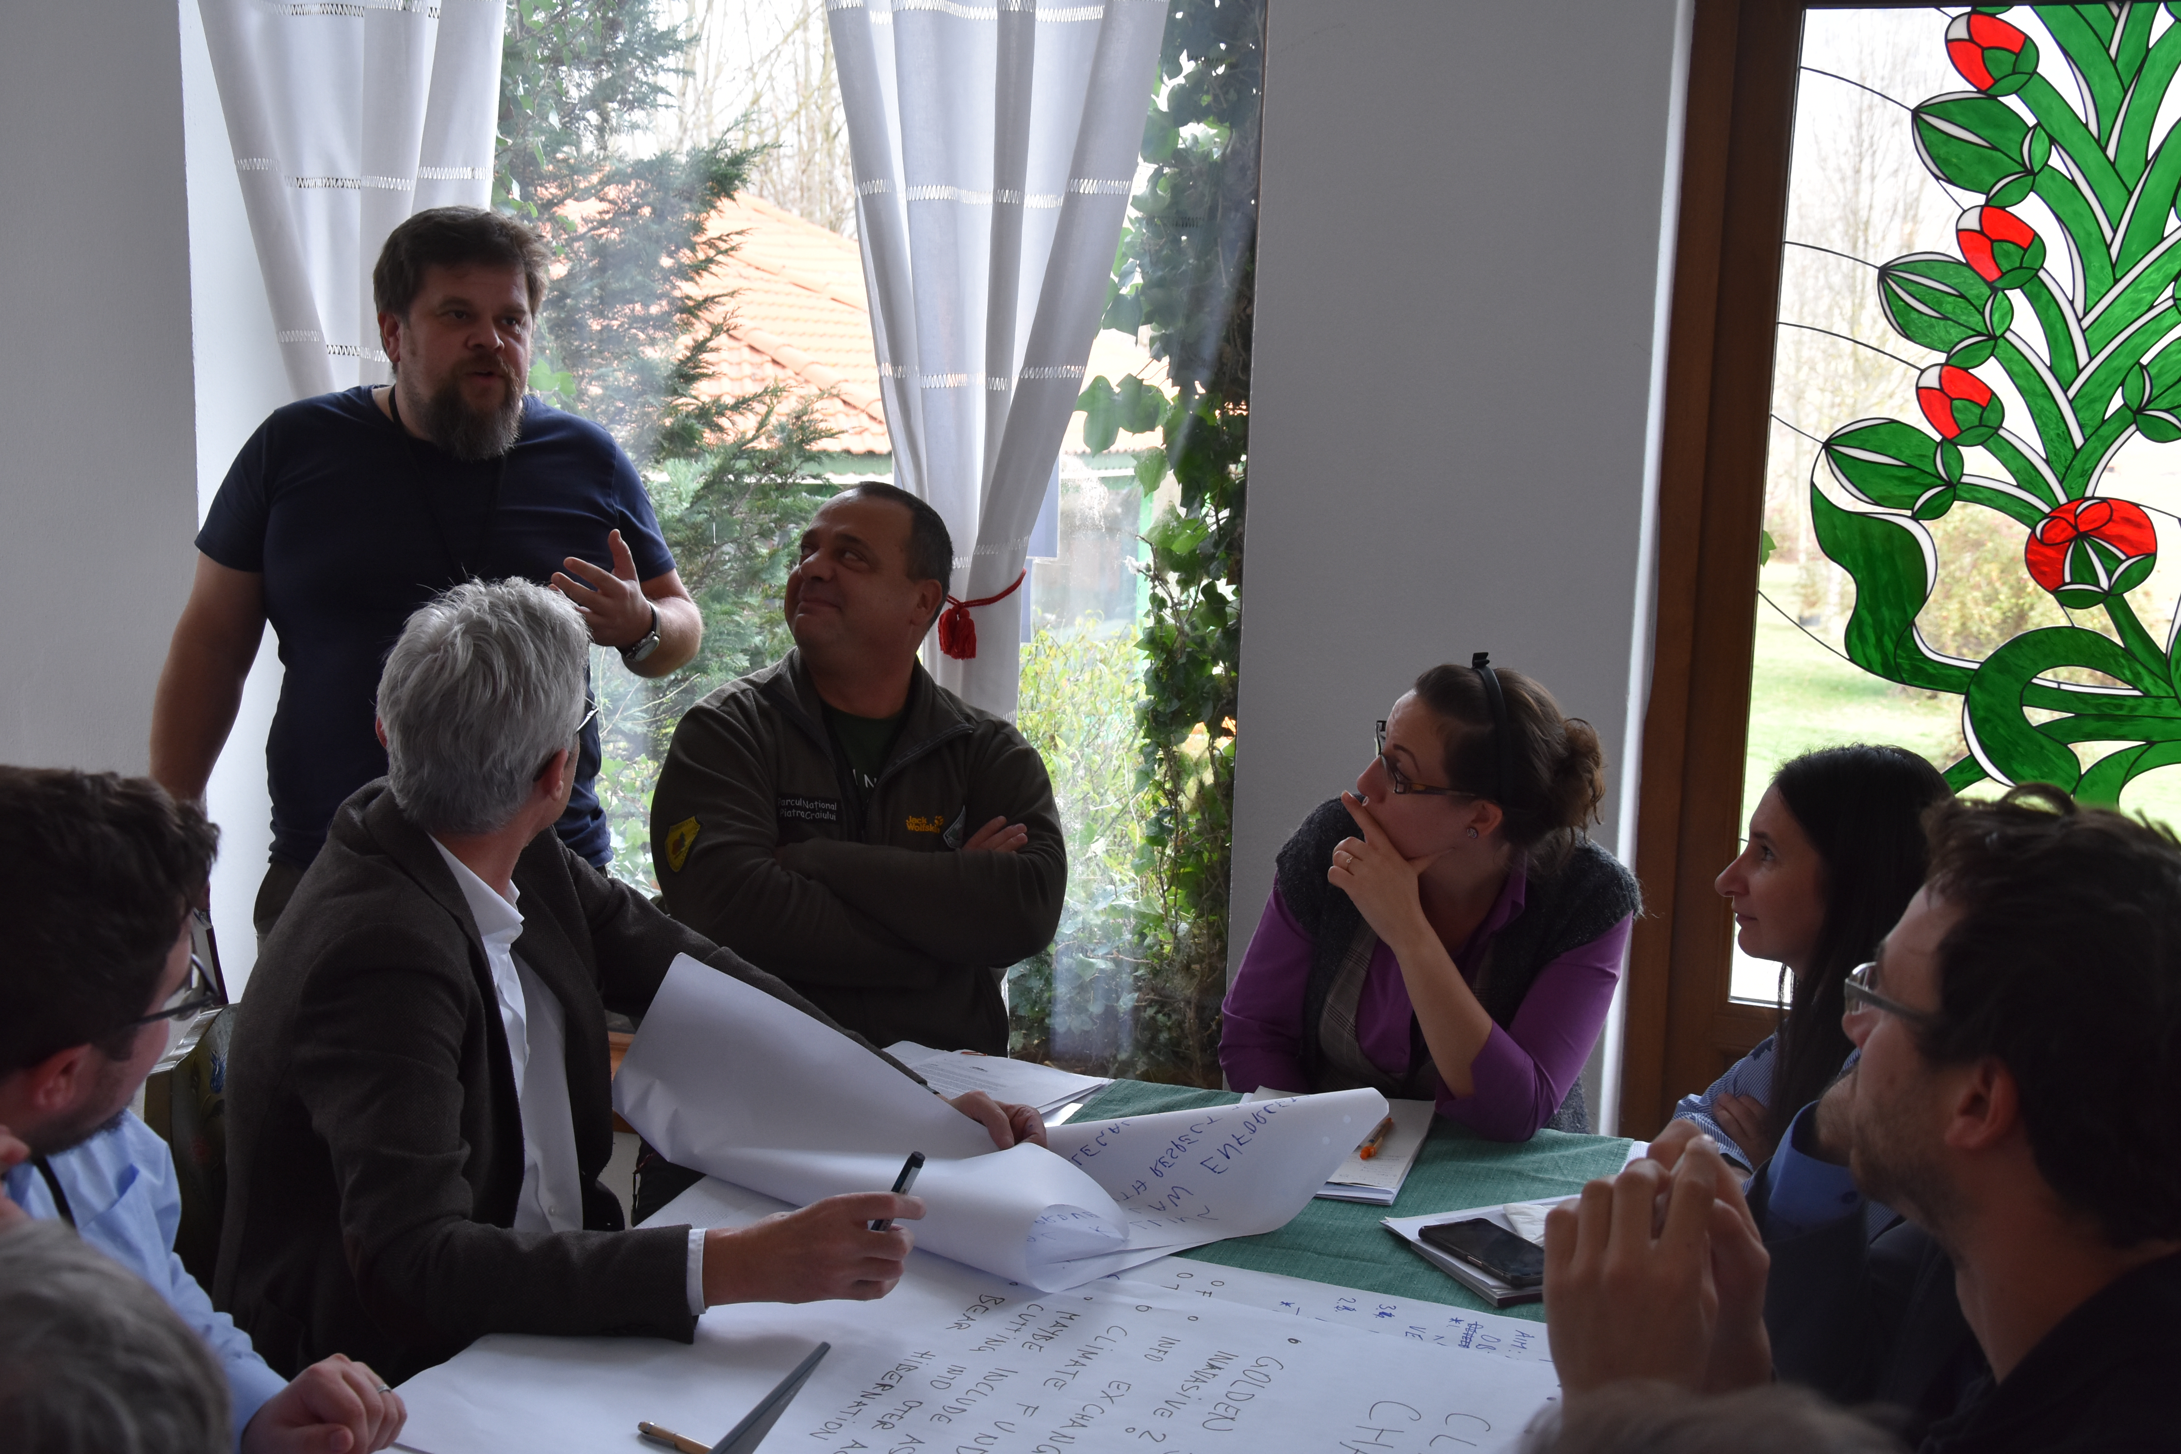
Meetings, field trips, trainings

Slide 52
Meetings, field trips, trainings

Slide 53


Thank you for your attention!

