Slide 1

EU Green Week
Zoom platform | 25th September 2020
Green Carpathians
Centralparks project – Building management capacities of Carpathian protected areas for the integration and harmonization of biodiversity protection and local socio-economic development
Isidoro De Bortoli – Eurac Research

Slide 2
centralparks
PROJECT
PARTNERSHIP
THE CARPATHIANS
INCREASING
THREATS UNDER
CENTRALPARKS
PERSPECTIVE
PROJECT SPECIFIC OBJECTIVES
PROJECT
OUTPUTS
PROJECT CHALLENGES
THE ROLE OF
CNPA

Slide 3
PROJECT PARTNERSHIP
Italy: European Academy of Bolzano/Bozen - Eurac Research (Lead Partner)
Austria: European Wilderness Society
Czech Republic: Education and Information Centre of Bílé Karpaty Mountains
Hungary: Danube-Ipoly National Park Directorate
Poland: Ekopsychology Society
Romania: NFA-Romsilva-Piatra Craiului National Park Administration R.A.
Slovakia: Pronatur NGO,
Slovakia: The State Nature Conservancy of the Slovakia

Slide 4
PROJECT PARTNERSHIP (Aps)
Italy: Ministry for the Environment, Land and Sea – IMELS
Austria: DANUBEPARKS
Germany: European Beech Forest Network
Hungary: CEEweb for Biodiversity
Ukraine: Ministry of Ecology and Natural Resources of Ukraine
Poland: Ministry of Environment of Poland
Romania: Ministry of Environment of Romania
Slovakia: Ministry of Environment of the Slovak Republic

Slide 5
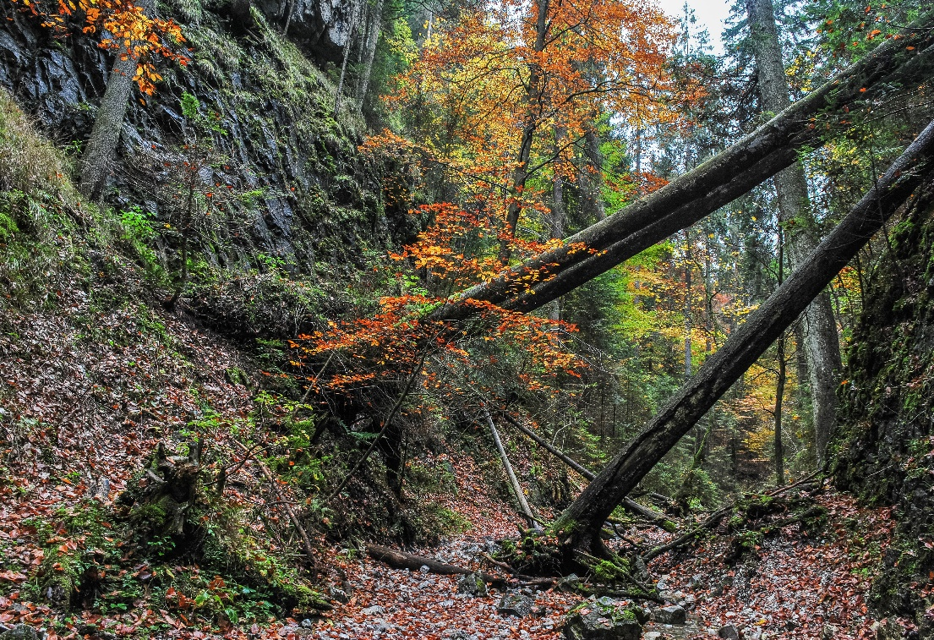
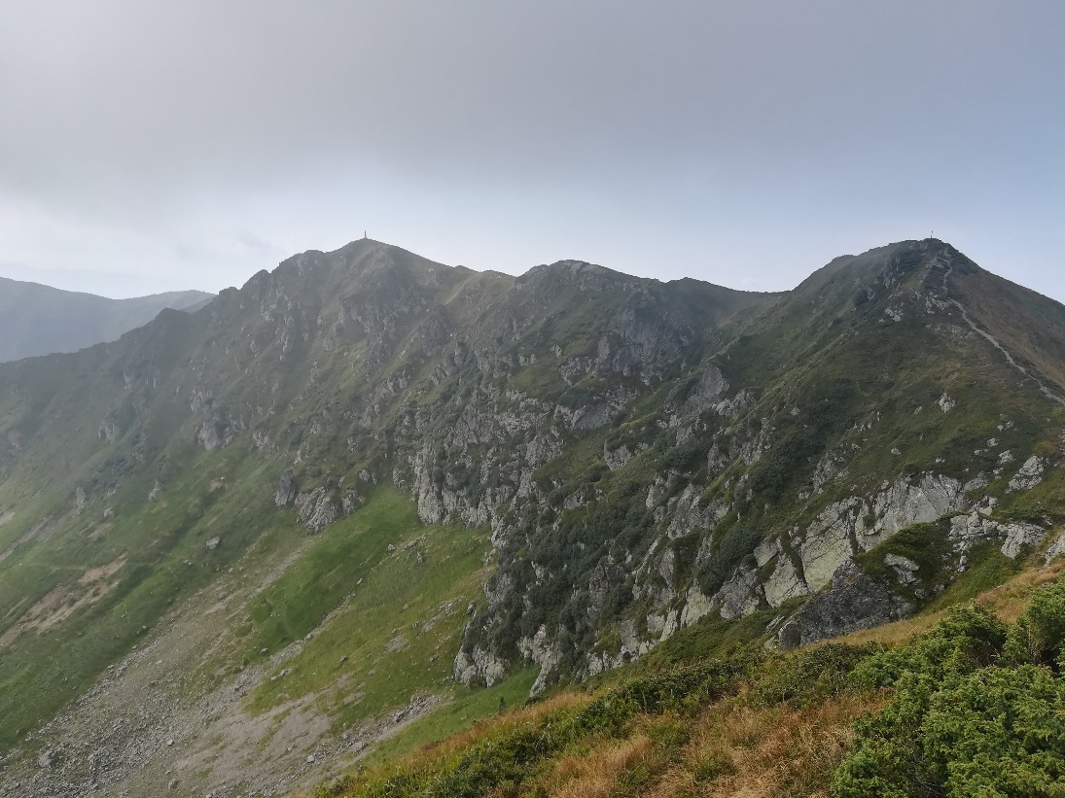
The Carpathians

Slide 6
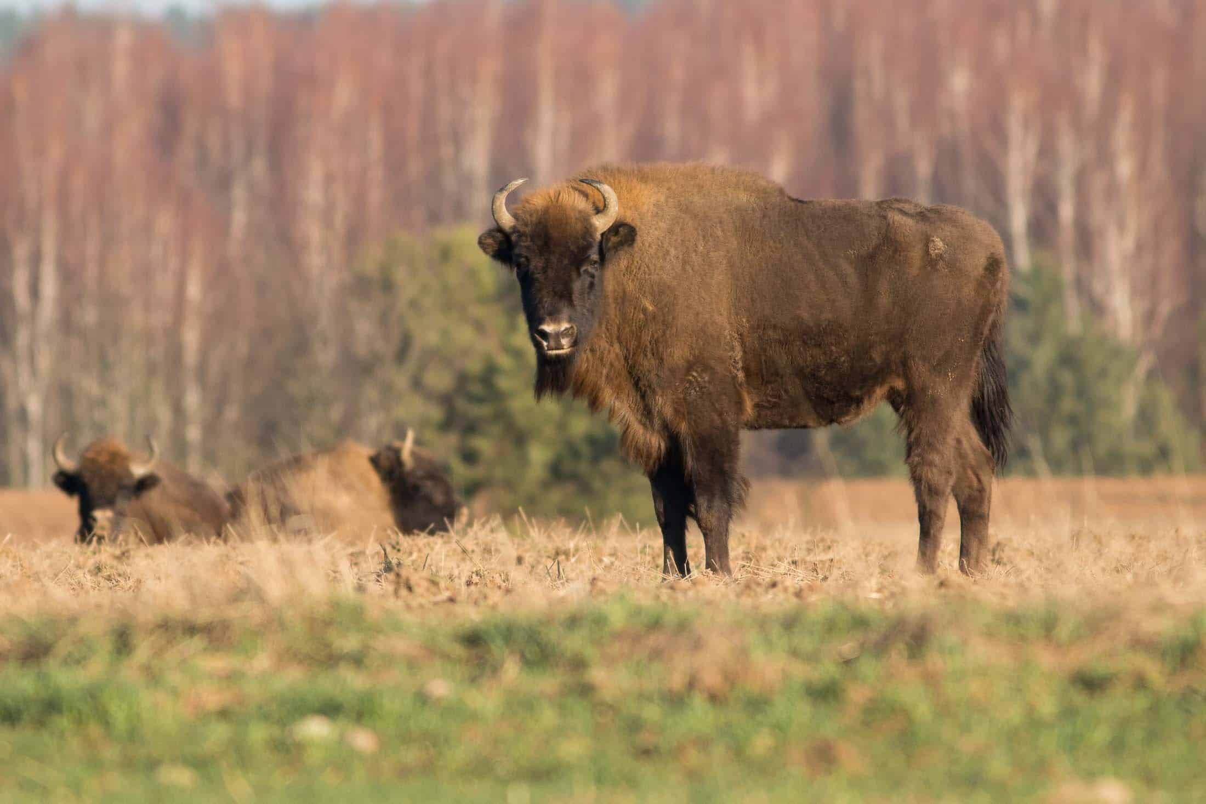
The carpathians
One of the most important European wildlife refuges
Harbours some of the last primeval beech forests
One-third of European endemic and threatened plant species
Supports vital populations of all large carnivores (brown bear, grey wolf, Eurasian lynx) and all big native herbivores (European bison)
Of the main European ecological corridors allowing migrations of animal populations and genetic exchange

Slide 7
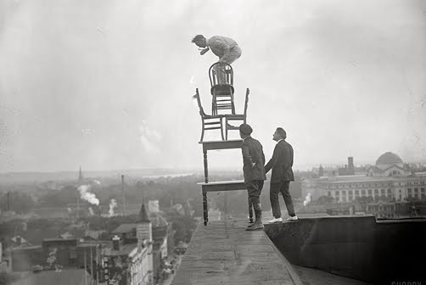
INCREASING THREATS
Infrastructure development
Tourism pressure
Habitat destruction and fragmentation
Poaching
Illegal logging
Pollution
Climate change
Over-harvesting
Inappropriate natural resource
Management methods
Nature conservation policies and management cultures vary among the Carpathian countries…
…Traditional approaches to natural resource management and biodiversity conservation will may no longer be sufficient to reach long-lasting economic benefits and provision of ecosystem services!

Slide 8
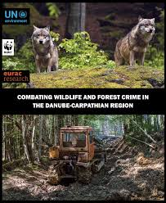
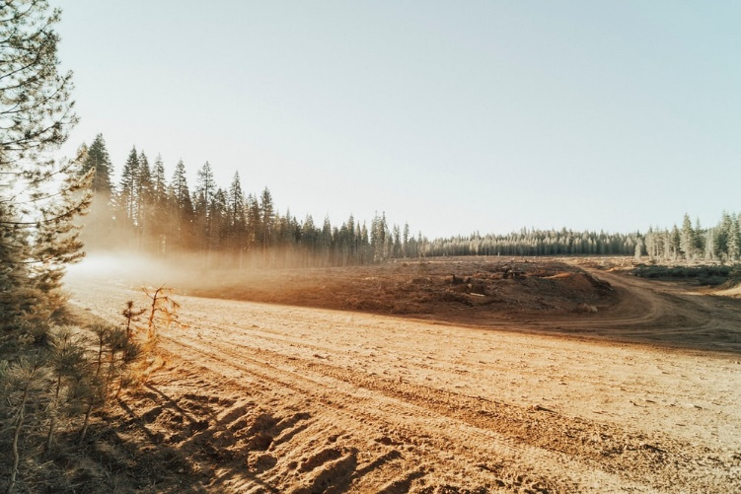
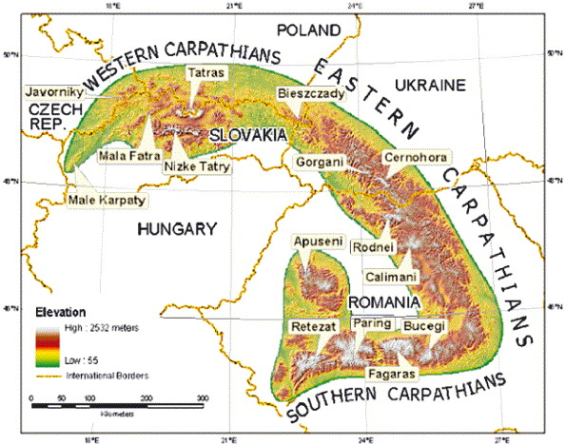
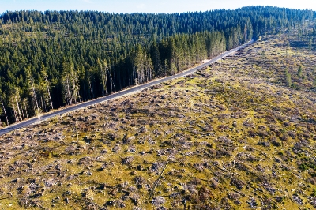
INCREASING THREATS
It's been known to happen..

Slide 9
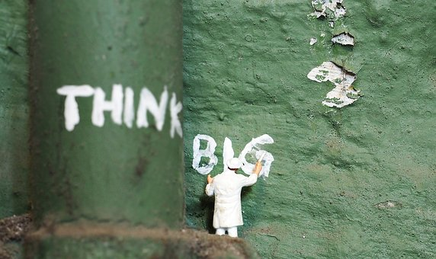
Project specific objectives
Improving integrated environmental management capacities of protected area administrations and other public sector entities dealing with the protection and sustainable use of natural resources
Reconciling and linking the conservation of biological and landscape diversity to sustainable local socio-economic development
Promoting the Carpathian Network of Protected Areas as the framework and tool for transnational collaboration between the protected areas of the Carpathian countries in the Central Europe cooperation area

Slide 10

Project specific objectives
TARGET GROUPS
Protected area administrations in the Carpathians
Local public authorities
National public authorities
Interest groups including NGOs
Nature conservation authorities
Higher education and research institutions active in the Carpathian region
General public

Slide 11
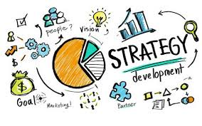
PROJECT OUTPUTS
WP T1: Integration of biodiversity conservation and sustainable development in the Carpathian region
Carpathian strategy for enhancing biodiversity and landscape conservation outside and inside protected areas
Pilot implementation on strategy for enhancing biodiversity conservation outside and inside protected areas
Strategy for local sustainable tourism development based on natural heritage of the Carpathians
Pilot workshops of the strategy for sustainable tourism development
Guidelines on communication between protected areas and local communities in the Carpathians
Training on effective communication between protected areas and local communities in the Carpathians

Slide 12
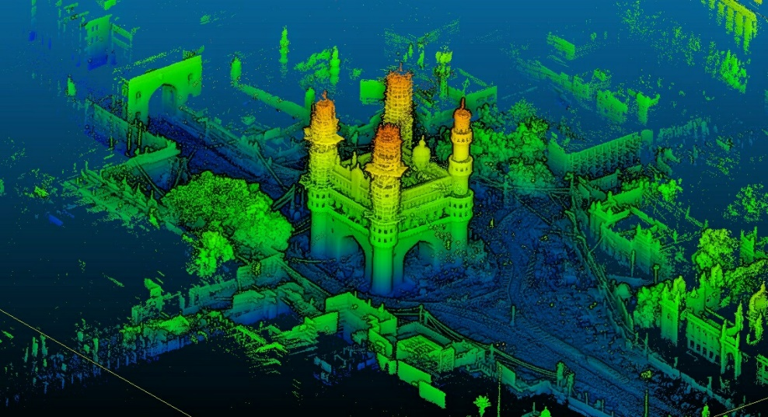
PROJECT OUTPUTS
  WP T2: Building capacities of Carpathian Protected Areas managers
  Strategic document on raising good protected areas management capacities
  Innovative habitat evaluation tool (LIDAR) for forest and grassland state evaluation
  Guidelines for proper integrated nature conservation planning
  Integrated Nature Conservation Management Plan
  Pilot testing of the LiDAR laser scan study on mountainous and river valley in Hungary

Slide 13

PROJECT OUTPUTS
  WP T3: Carpathian Ecosystem Services Toolkit
  Carpathian Ecosystem Services Toolkit (CEST)
  Training programme for local/regional authorities for using the CEST

Slide 14
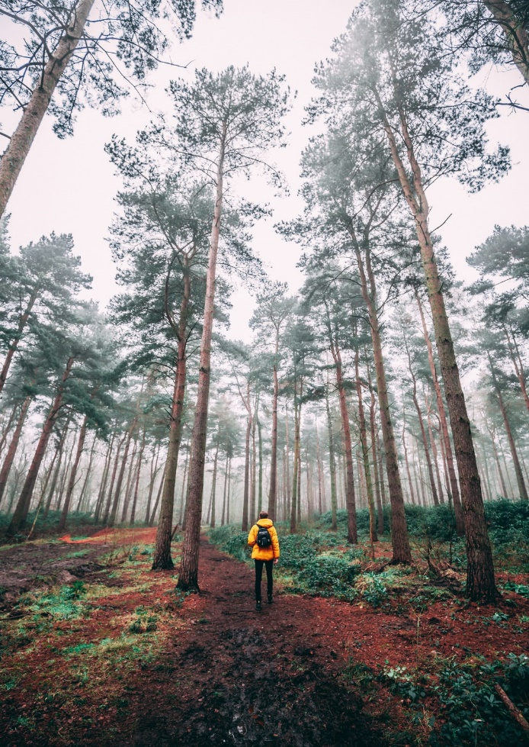
PROJECT CHALLENGES
Reconciling nature conservation and local socio-economic development, raising support and involvement of local communities
Encouraging transnational networking, harmonizing approaches at the international level, and facilitating the harmonization of measures undertaken in border areas and transboundary-protected areas

Slide 15

PROJECT CHALLENGES
Promoting joint actions for integrated management of biodiversity, including joint transnational thematic task forces, involving experts from Carpathian countries
Developing and testing innovative environmental management tools
Strengthening the role of the Carpathian Convention in implementing the cohesion among the member states

Slide 16


THE ROLE OF CNPA
Networking is a life skill, and it is in PAs managers' interest to acknowledge its importance and develop their own networking skills in the Carpathians area.
Developing and maintaining relationships with others for the purpose of mutual benefit can help PAs search for and secure awareness opportunities, gain access to needed environmental information or resources— especially on short notice—and obtain guidance, political and social support

Slide 17

THE ROLE OF CNPA
It is in the intent of the project to try to revitalize the CNPA, through the restarting of the main communication mechanisms within the official decision-making board.
Activating specific round tables, involving the official members, guaranteeing the endorsement of the Carpathian Convention, promoting all the Carpathians-related project contents, to pave the way for drafting new Carpathian projects ideas.

Slide 18
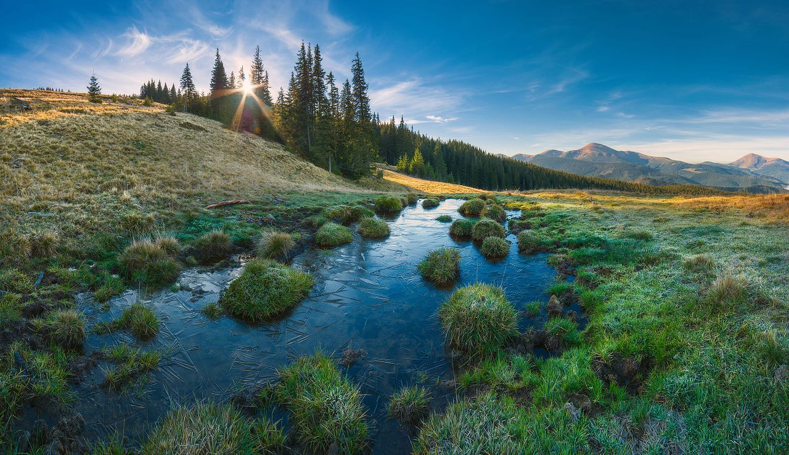
Thank you for your attention!

Slide 19
centralparks
Isidoro De Bortoli
Institute for Regional Development – Eurac Research
Centralparks project
https://www.interreg-central.eu/Content.Node/Centralparks.html
isidoro.debortoli@eurac.edu
+39 0471 055421
https://www.facebook.com/Centralparks

Slide 20






